Slide 1
Electricity & Lighting
ACE Mentorship – Engineering Session 2

Slide 2



Overview
ELECTRICITY
APPLICATIONS IN BUILDINGS
LIGHTING

Slide 3
Electricity
Definition:
“A fundamental form of energy observable in positive and negative forms that occurs naturally (as in lightning) or is produced (as in a generator) and that is expressed in terms of the movement and interaction of electrons.”
https://www.merriam-webster.com/dictionary/electricity

Slide 4
Electrical terms
VOLTAGE (V)
AMPAGE (A)
Electronic Pressure – Makes Electricity Move
Strength of Electrical Current
WATTS (W)
OHMS (Ω)
Rate of Energy Transfer – Output of Voltage
Electrical Resistance of a Circuit

Slide 5
ELECTRICITY - The basics
TYPES OF ELECTRICITY
APPLICATIONS OF ENERGY
  AC/DC
  How is this used?
ELECTRICY IN BUILDINGS
SAFETY
  General overview of how it works
  Being safe

Slide 6
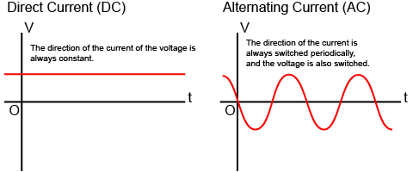
Types of Electricity
Two Main Types:
DC: Direct Current (One Way Flow)
AC: Alternating Current (Changes flow based on magnetic field)
Take Away: Commercial/Residential is AC Power.

Slide 7
But How does it work?
SIMILAR TO WATER
Electricity flows much like water, thru specified pathways to specific locations.
ORIGIN
For a building, the electricity enters in thru a main connection from energy grid.
HOW IS THIS CONTROLLED
Energy is controlled thru breaker boxes to prevent damage.
HOW DOES THIS MOVE THRU BUILDINGS
Wire distribution system

Slide 8
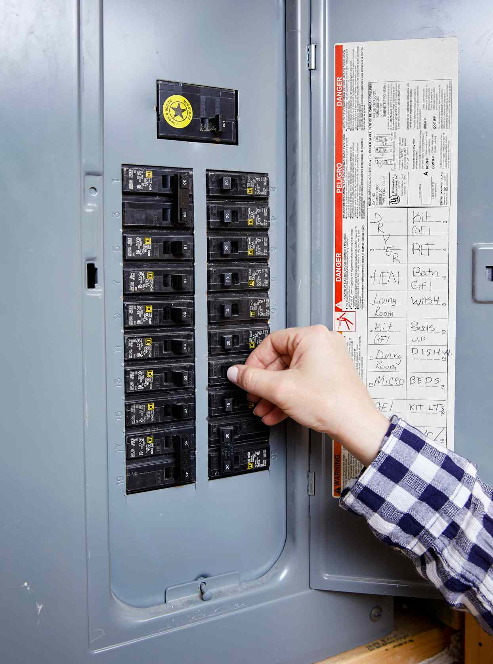
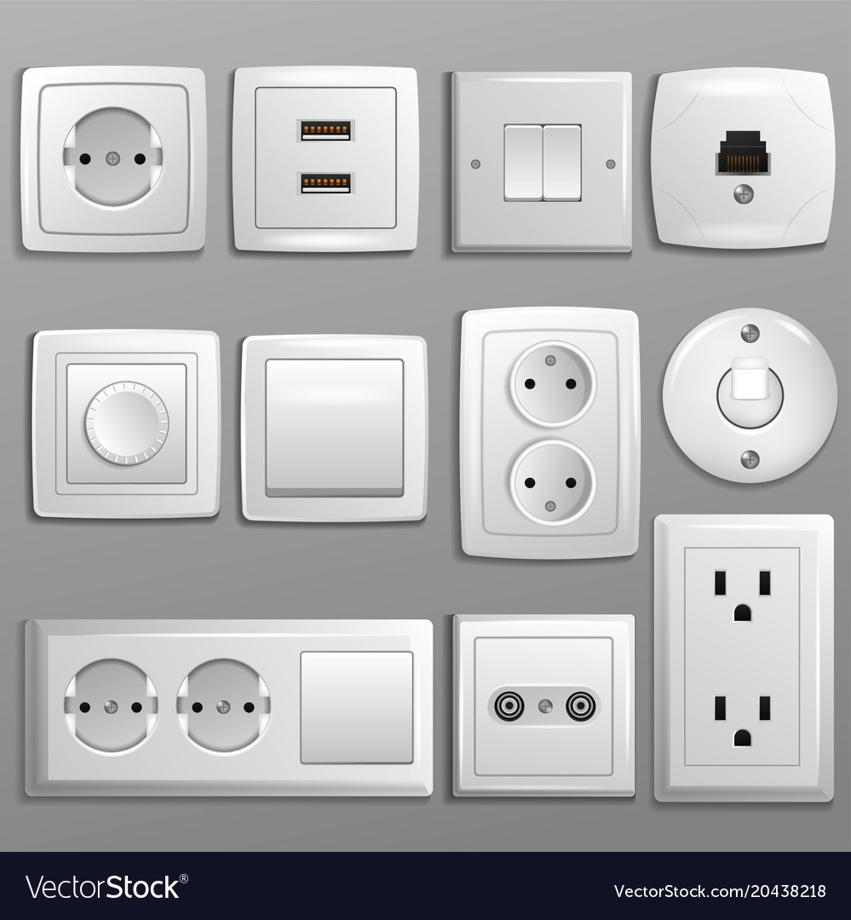
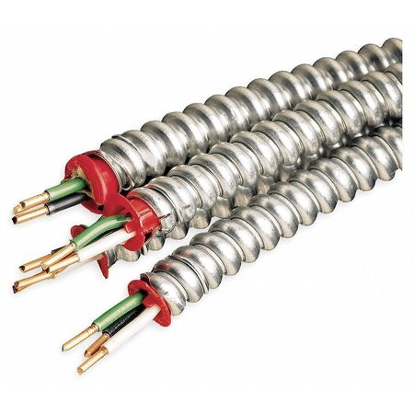
BASICS OF Circuits
Protection/Control Devices
Wiring
Connections
Breaker Box
Phases Energy to Circuits
Raceways
Busways
Cable Assemblies
Gauge
Wall Sockets
Light Fixtures
Switches

Slide 9
Electricity in Buildings
Low
Medium
High
240 to 600 Volts
House Holds
2,400 to 69,000 Volts
Data Center
69,000 – 1,100,000 Volts
Manufacturing Facility

Slide 10
Applications of Electricity
HEATING / COOLING
LIGHTING
Air Handling Units, heat pumps, hot water heaters.
**Largest consumer of energy
Ceiling panel lighting and controls.
HIGH ENERGY APPLIANCES
LOW VOLTAGE ITEMS
Elevators, Escalators, Refrigerators, Ovens, Stoves.
Security systems, HVAC Controls, Switches

Slide 11
The why
Understanding of how energy is used determines protection requirements – Load Dynamics and Distribution

Slide 12
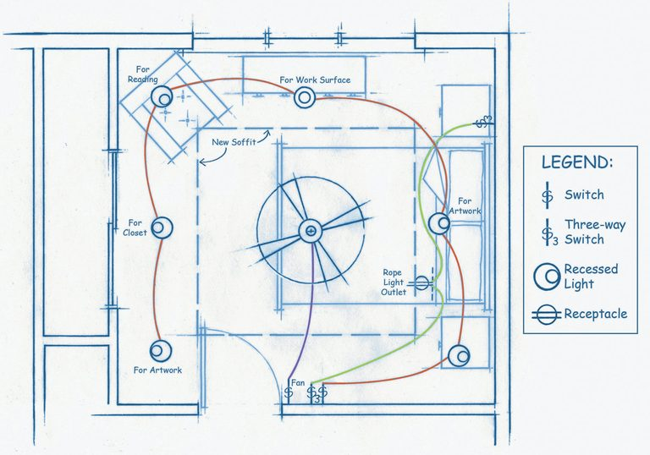
The Basics
At a glance, one room

Slide 13
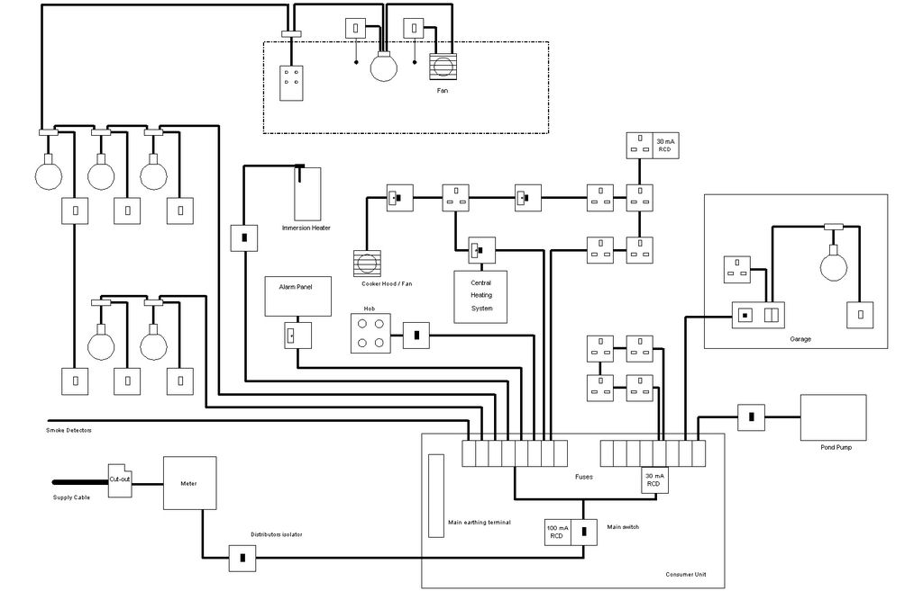
Engineering
How is this shown in drawings?
WHY does this matter?

Slide 14
Lighting - An OVERVIEW

Slide 15
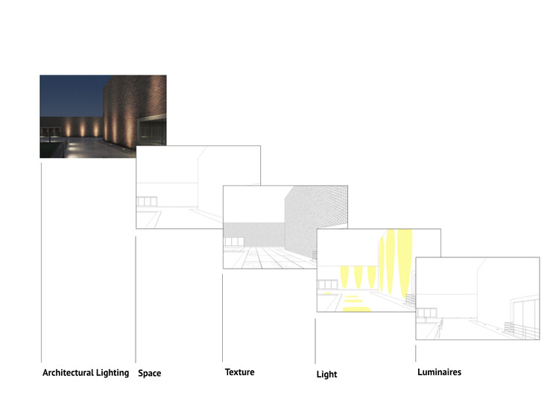
What is Lighting?
Lighting is for both interior and exterior applications.
Practical Applications:
Adds light for safety and useable space.
Architectural Application:
Space, Texture, Depth, and Highlights Design Elements.

Slide 16
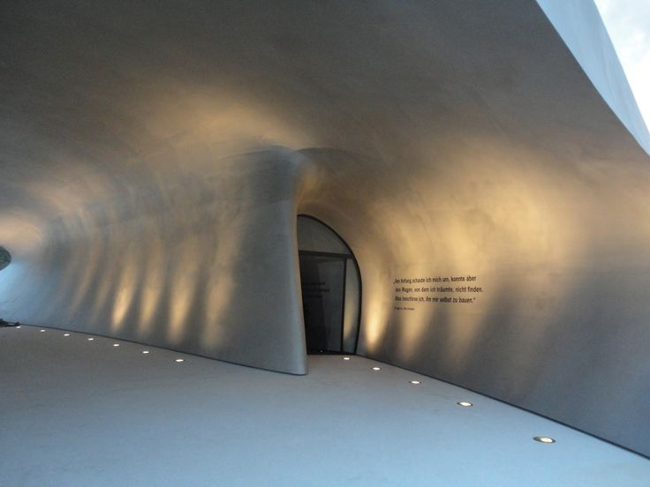
Light Types
Types:
Incandencent
Halogen
Florecnet
Induction
LED

Slide 17



Types of Lighting – Which type?
Purpose
Architectural
Enhancement
To add light to an area
(Interior & Exterior)
To enhance architectural features or spaces
(Interior & Exterior)
To enhance places with Experience
(Interior & Exterior)

Slide 18
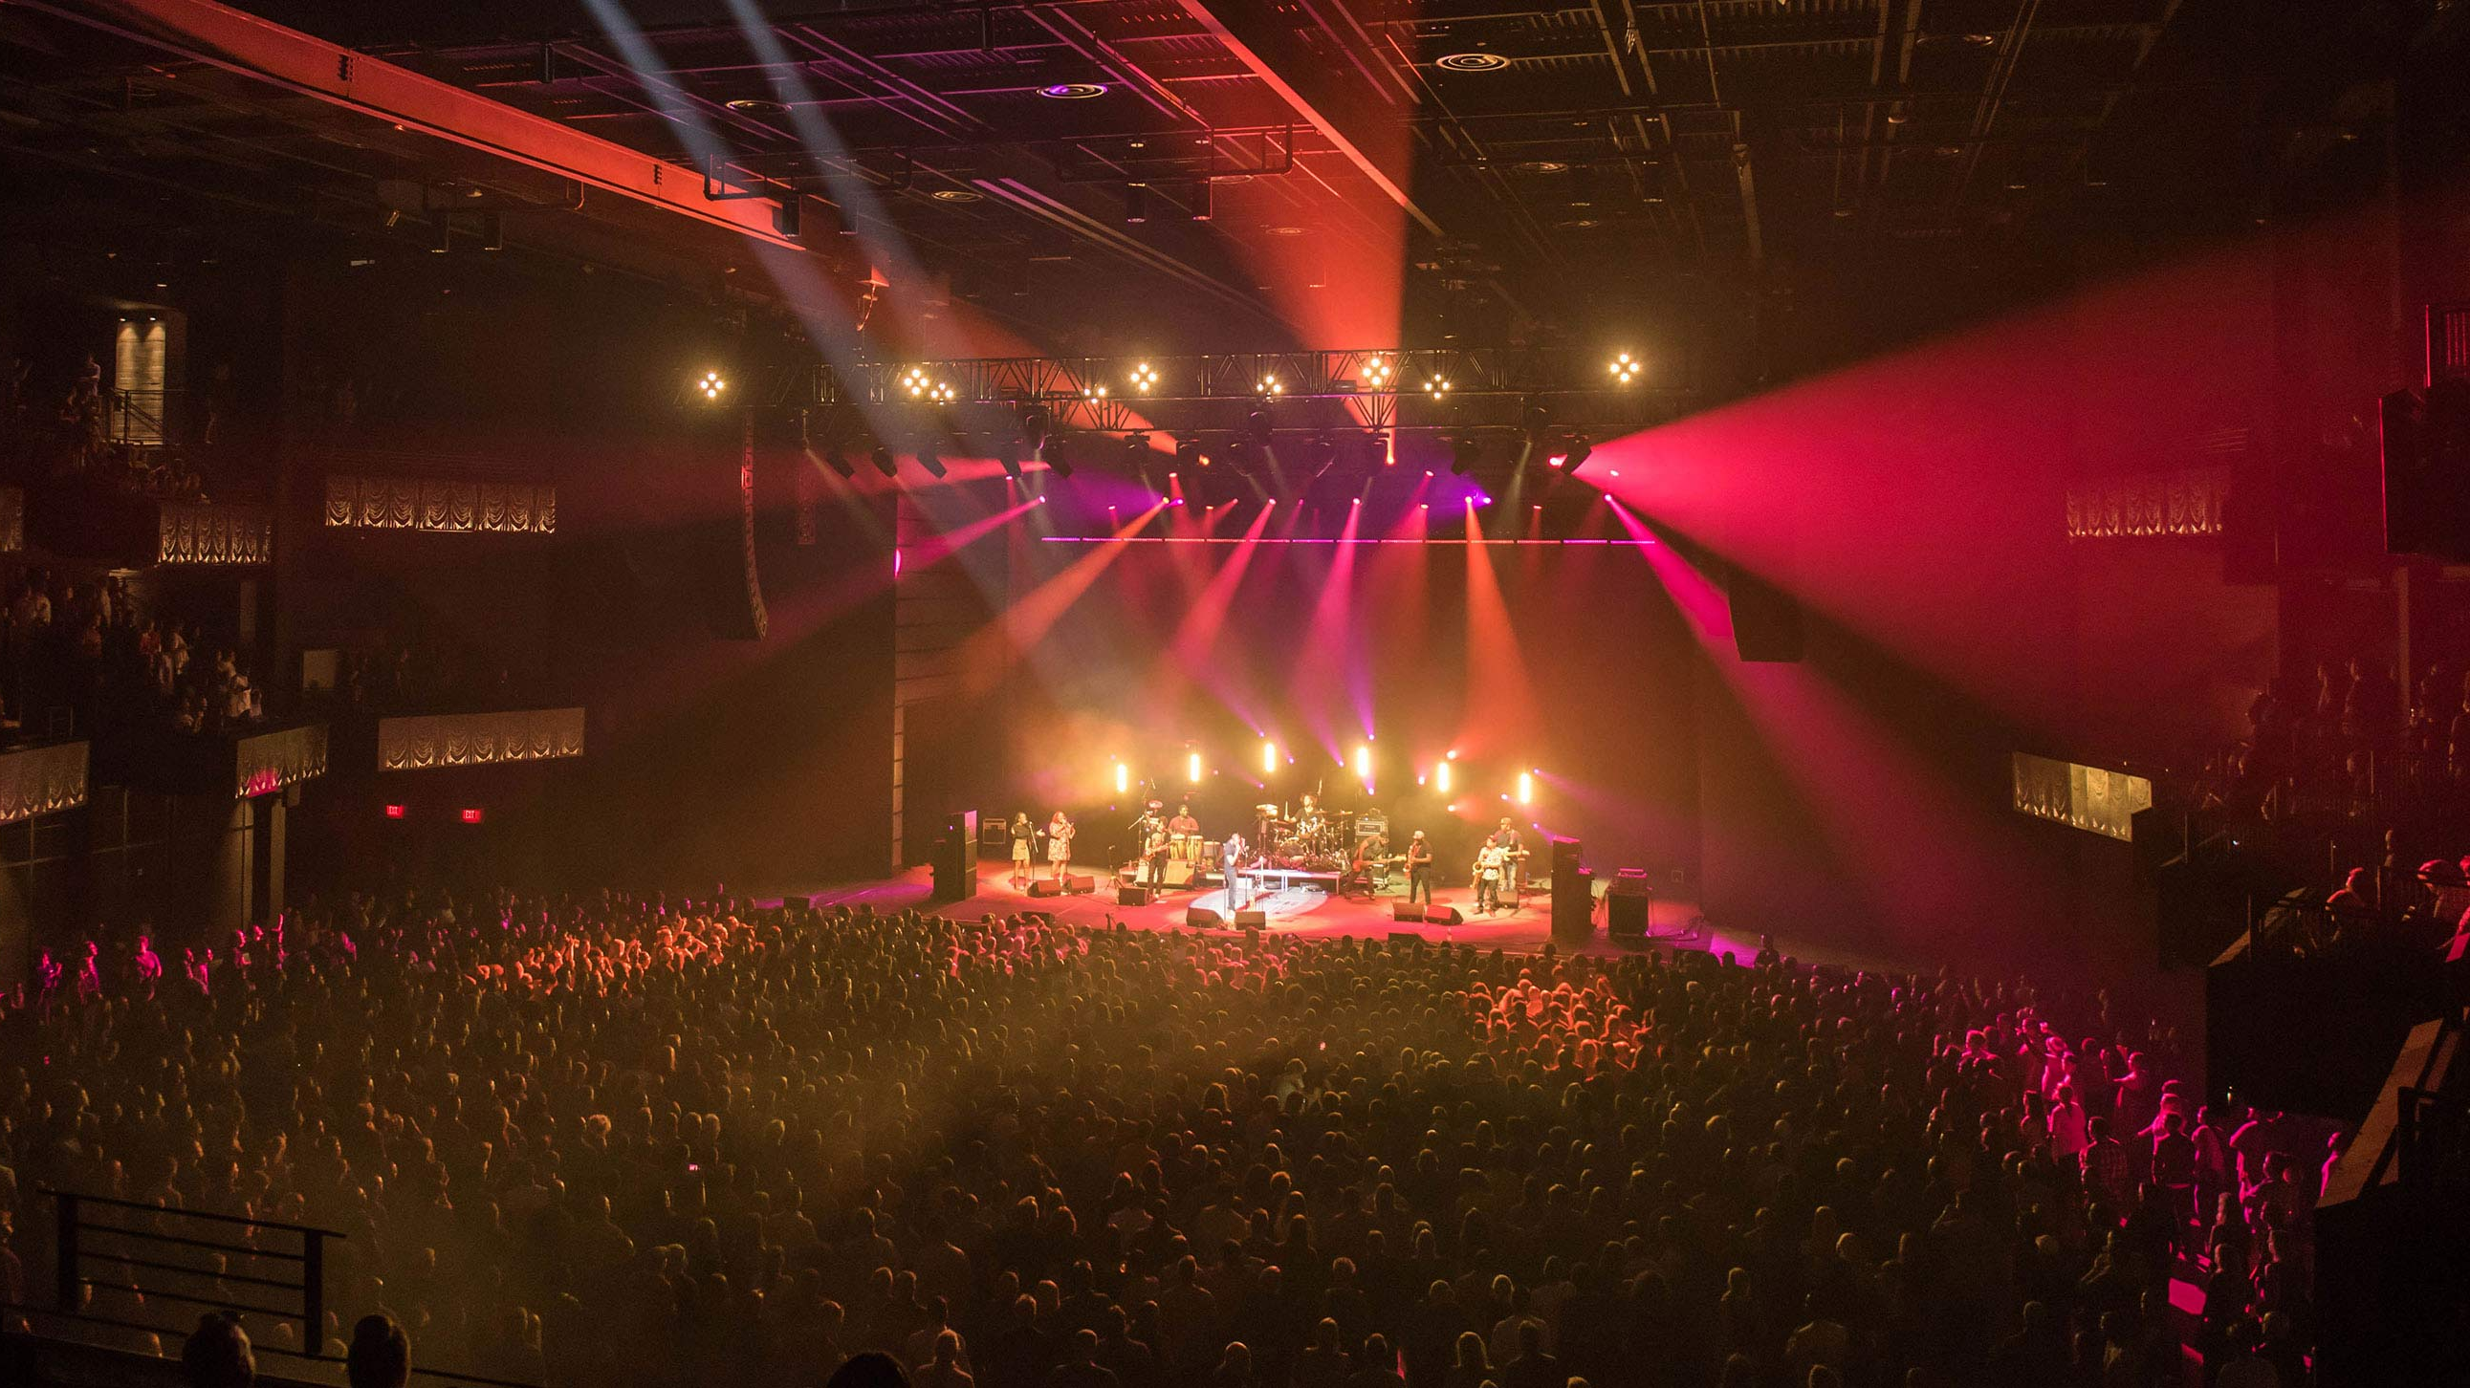
Stage Performance – Lighting

Slide 19
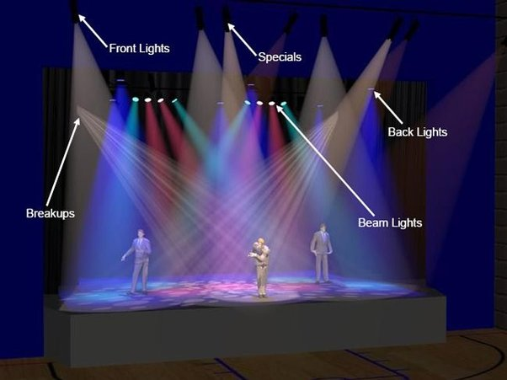
Types of Stage Lighting

Slide 20
The Next Steps

Slide 21
Engineering Application
To apply electrical and lighting to existing architectural drawing using drafting paper.
Using colored pencils draw electrical connections, high/low energy wiring, and breaker box.

Slide 22
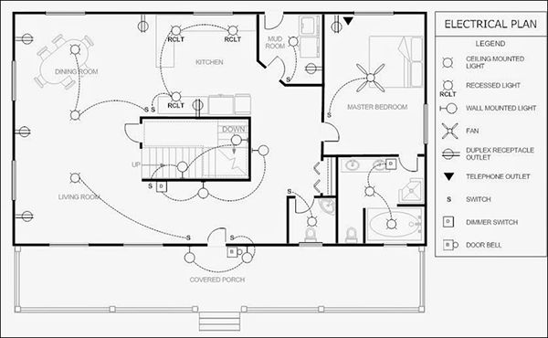
Example of Applied Engineering
The deliverable.

Slide 23
THANK YOU
ACE Mentorship Team

