Slide 1
AcE Mentorship – Engineering
Session One – Site, Core/Shell, and Roof Planning

Slide 2
AGENDA
Introduction
Primary goals
Sitework
Core & Shell
Roofing
Summary

Slide 3
INTRODUCTION
To review the engineering of jobsite, Core/Shell components, and roofing layouts.​ This includes the selection of materials, water reclamation plans, and enclosing of structures.

Slide 4
PRIMARY GOALS
To take engineering concepts and apply them to Students’ existing design.

Slide 5
What is engineering?
Definition: ​ “the application of science and mathematics by which the properties of matter and the sources of energy in nature are made useful to people.”
Reference: https://www.merriam-webster.com/dictionary/engineering

Slide 6
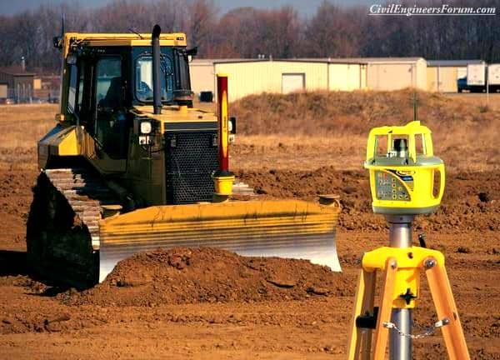
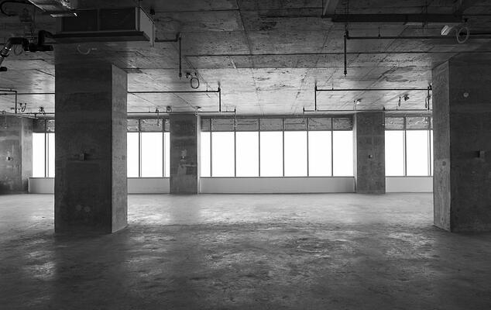
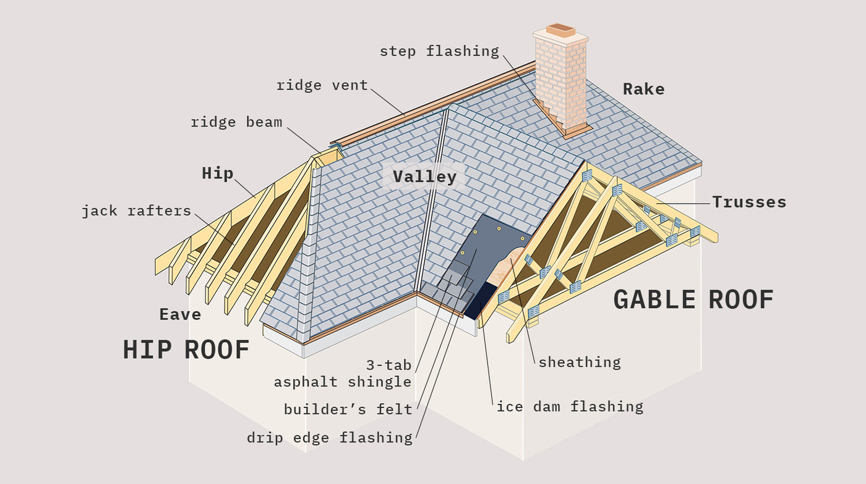
Applied Engineering Concepts
Site Work
Core & Shell
Roofing Structure

Slide 7
Commonalities - Constraints
End Use
Does this make sense for the end user?
Cost
Is there funding for this concept?
Engineering
Is the design safe and constructable? Does this meet the local and regional building codes?
Re-evaluation
A constant process.

Slide 8
Sitework
Work Performed on the Jobsite

Slide 9
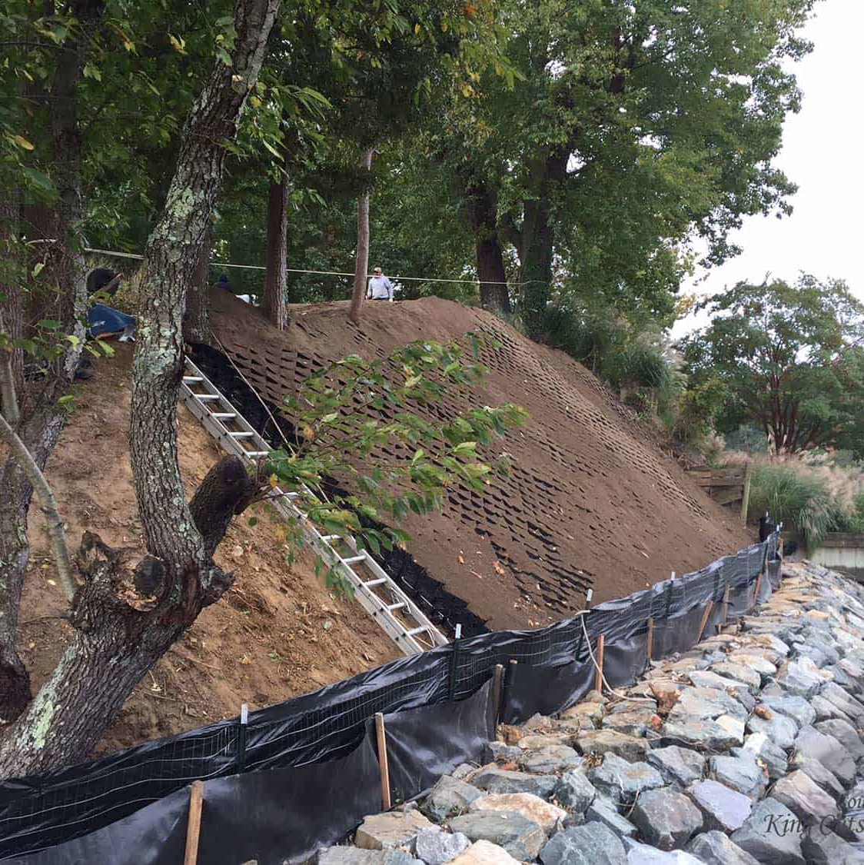
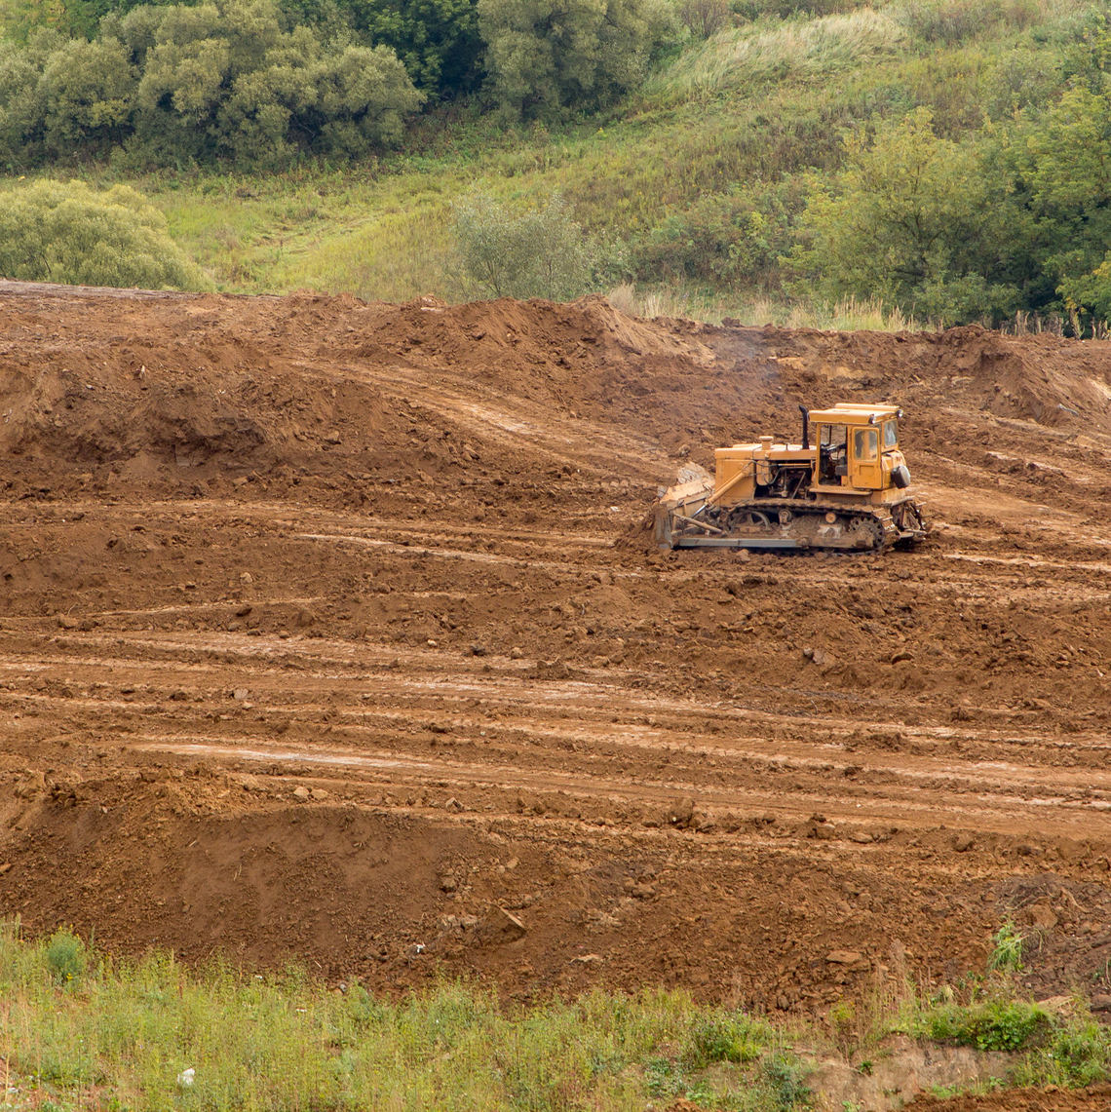
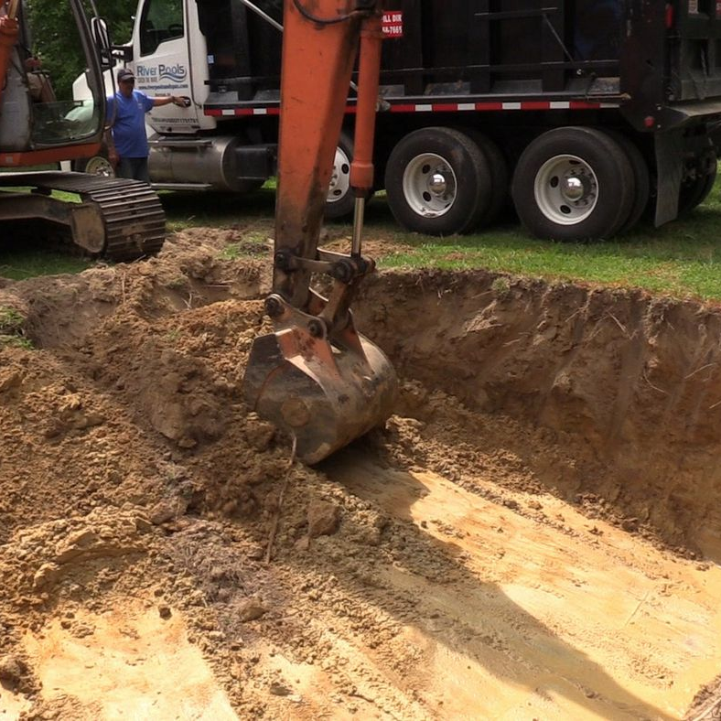
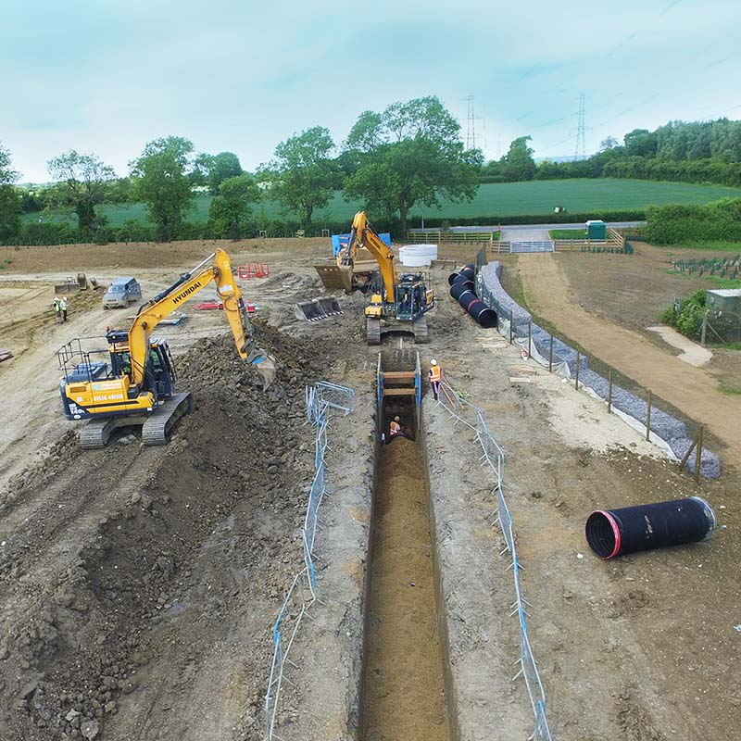
SiteWork
Erosion Control
Grading/Clearing
Excavation / Shoring
Drainage / Water Systems
Protection of Worksite and Surrounding Areas from weathering, collapse, and runoff.
Preparation of Jobsite by the removal of debris and shaping of jobsite.
Removal of excess or unsuitable soils for installation of foundation.
Creation of Water Remediation, both Temporary and Permanent.

Slide 10
Erosion Control
Erosion Control
Protects from Weather
Protects Environment, Jobsite, and Community

Slide 11
Grading & Clearing
PURPOSE:
Clear of Debris on Jobsite
Grade and Level Plot Per Design
Prep Jobsite for Construction

Slide 12
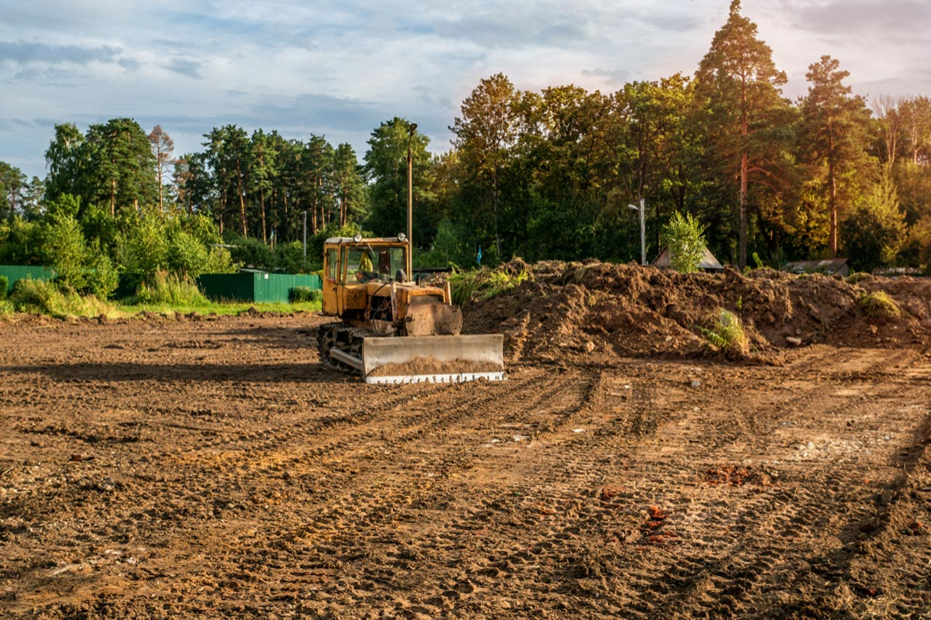
Grading & Clearing

Slide 13
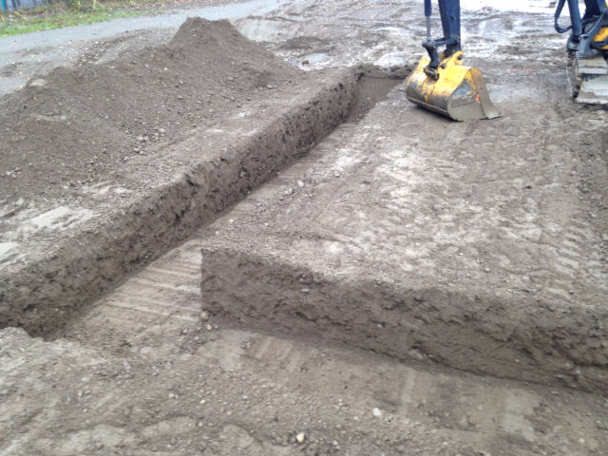
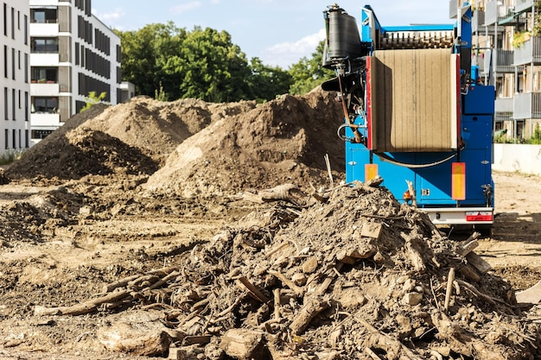
Excavation & Shoring
Removal of Unused Soil
Removal of Unsuitable Soils

Slide 14
Excavation & Shoring
Shoring
Stabilize Soils & Surroundings
Protects Workers & Jobsite

Slide 15
Drainage & Water Systems
Drainage
Temporary or Permanent Systems to Remove Water
Water Systems
Systems to Reclaim and Repurpose Water

Slide 16
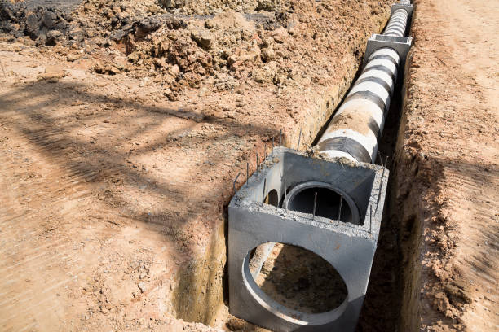
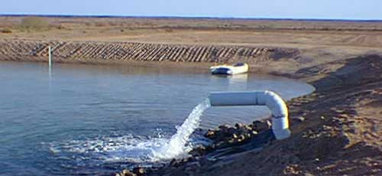
Drainage

Slide 17
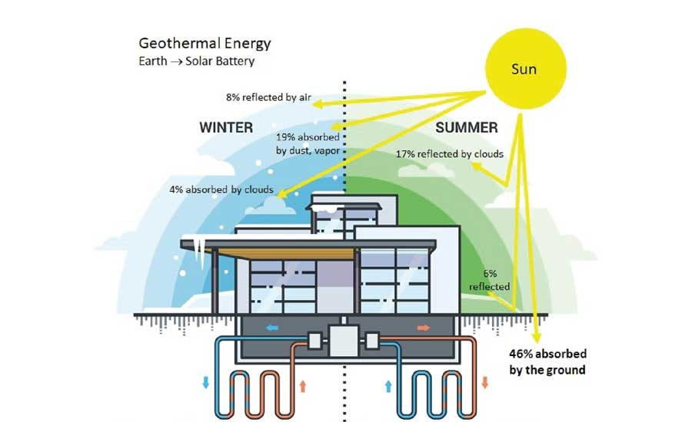
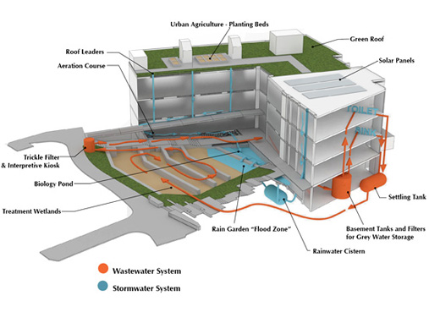
Drainage & Water Systems

Slide 18
Core & Shell
Time to Build a Building

Slide 19
Core & Shell
The core & shell is considered the skeleton (supporting structure) and enclosure of a permanent building. Also referred to as Base Building.

Slide 20
Foundation
All permanent structures are based upon a foundation. Foundations provide strength of the building, prevent permeation of moisture, protect from weather elements, and help to control movements of earth.

Slide 21
Foundation - Composition
Shallow
Isolated Spread Footing
Wall/Strip Footing
Deep
Pile
Pier
Cantilever/Strap Footing
Raft
Caisson

Slide 22
Which one to select?
Use
Existing Conditions
Future Plans

Slide 23
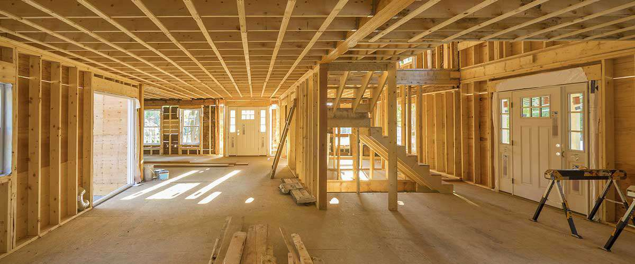
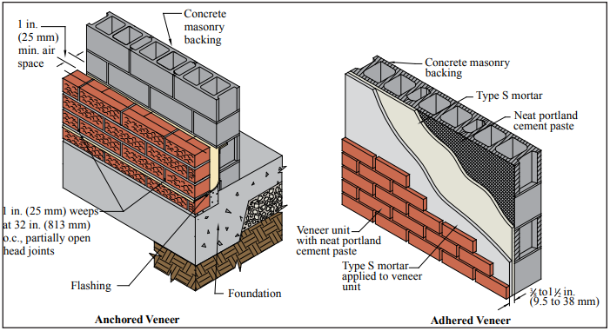
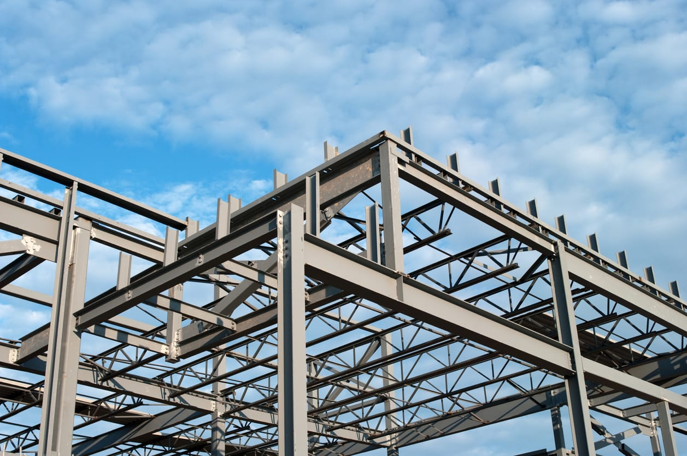

Core & Shell - Composition
Wood
Masonry & Concrete
Steel
Glazing
Commonly used in residential and light commercial
Multiple use such as Base Building, Walls, or Floors
Used in taller structures
Used in multiple structures

Slide 24
Core & Shell - Composition
Wood
Pro – Resistance to Weather, Pests, Mold, Fire, Reclaimed Materials, Prefabrication
Con – Weight, Steel Reinforcement, Conduit Restrictions, Cost
Steel
Pro – Durability, Strength, Quick Assembly, Sustainable
Con – Rust, Material Availability, Conductor of Heat, Metal Fatigue
Glazing (Glass)
Pro – Transparency, Aesthetic Appeal, Weather Resistance, Sustainability
Con – Cost, Brittleness, Severe Weatherproofing, Glare, Heat Transparency, Maintenance
Masonry / Concrete
Con – Stability, Pests, Fire
Pro – Variation, Maintenance, Weight, Ease of Repair

Slide 25
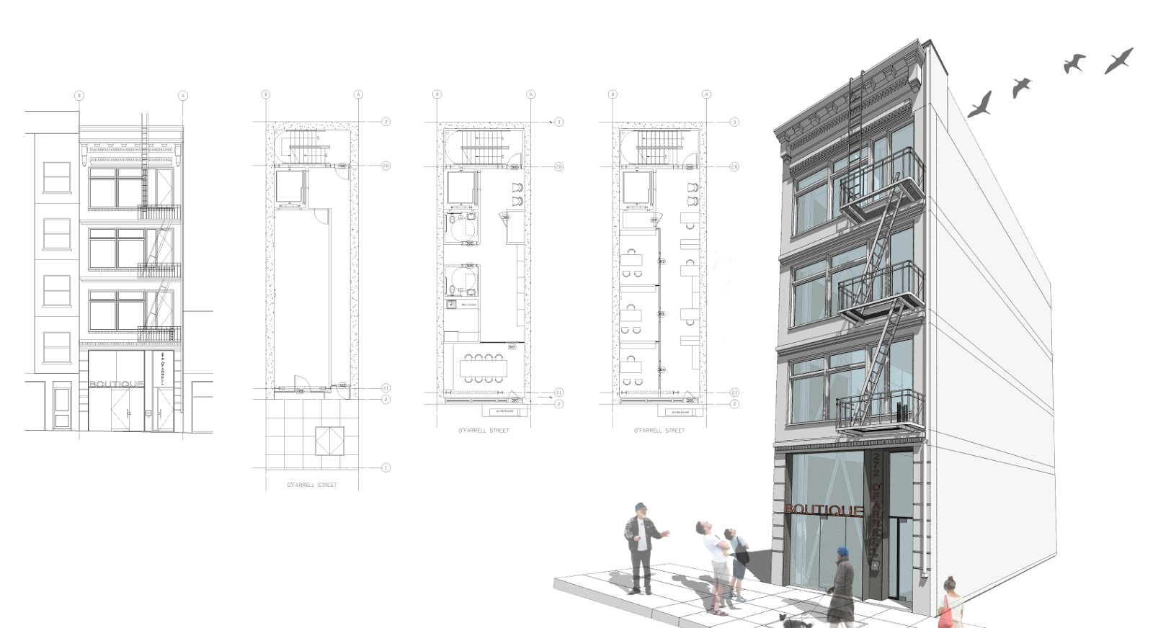
Core & Shell - Composition

Slide 26
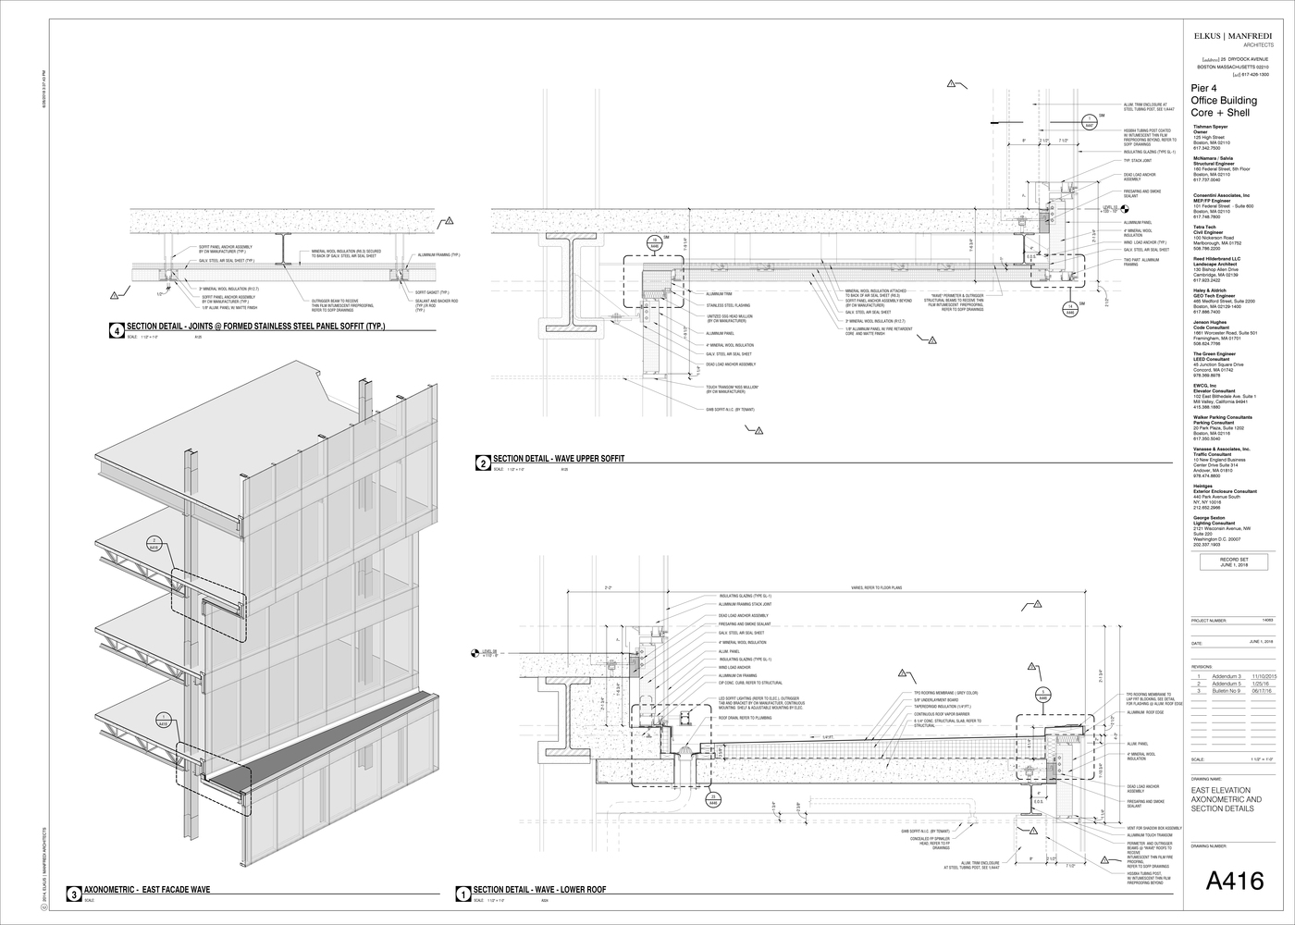
Core & Shell - Composition

Slide 27
Which one to select?
Use
Existing Conditions
Future Plans

Slide 28
Wall enclosures & Framing
Wood
Used as Internal Framing
Can Be Used in External Applications
Steel/Metal
Used as Internal Framing or Supporting Structure
Commonly used to protect high traffic industrial manufacturing walls or Corrugated Exterior Walls
Concrete/Masonry
Prefabricated used in External Applications (Concrete)
Composite Materials
External: Vinyl Siding, Metal Polystyrene Cladding Systems
Internal: Drywall, Tyvek, Ridged Foam, Tile, Plaster
Can be used in Interior/Exterior Applications

Slide 29
Roofing
Enclosing the Building

Slide 30
Roofing
The basic function of a roof is to offer protection for those items or individuals under its protection.
Also provides support to the walls or roof top mechanicals.

Slide 31
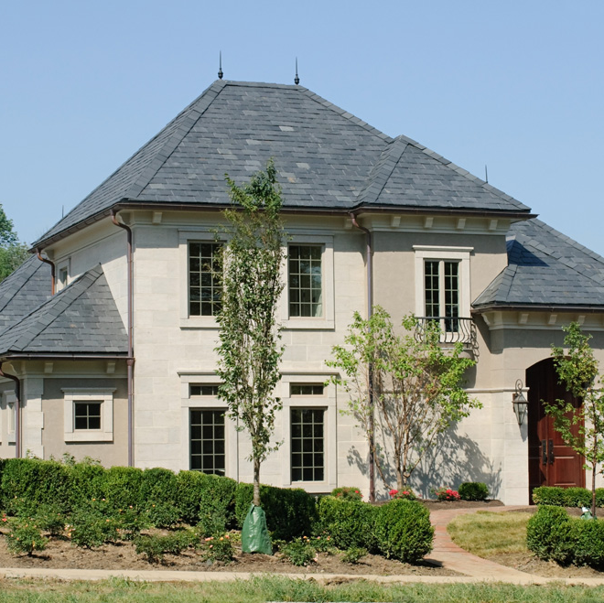
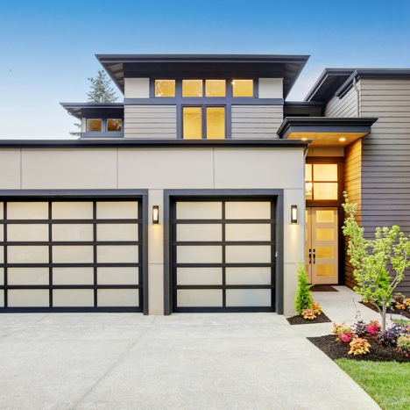
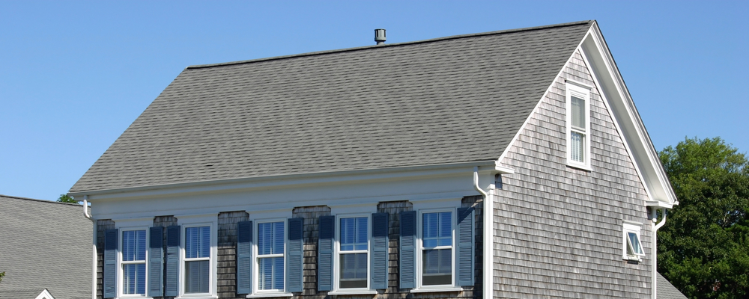
Roofing Types
Hip
Gable
Flat
x
Commonly used in residential and light commercial
Commonly used in residential and light commercial
Commonly used in Commercial structures
s

Slide 32
Roofing - Composition
Hip
Pro – Simple Design, Less Expensive, More Attic Space, Better Ventilation
Con – Prone to Damage in High Winds
Flat
Pro – Durability, Strength, Quick Assembly, Sustainable
Con – Rust, Material Availability, Conductor of Heat, Metal Fatigue
Gable
Con – More Complex, Less Attic Space
Pro – Self Bracing, Better Load Resistance

Slide 33
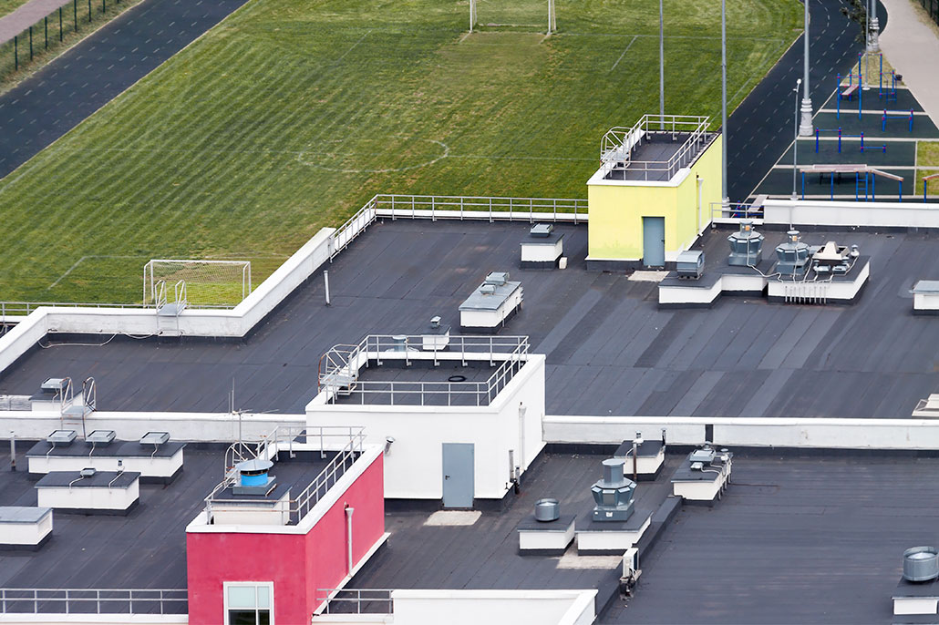
Commercial Roofing

Slide 34
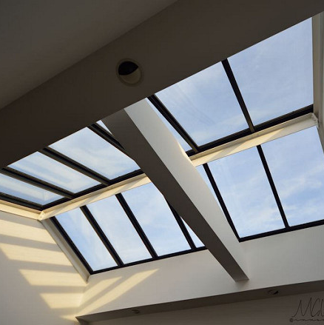
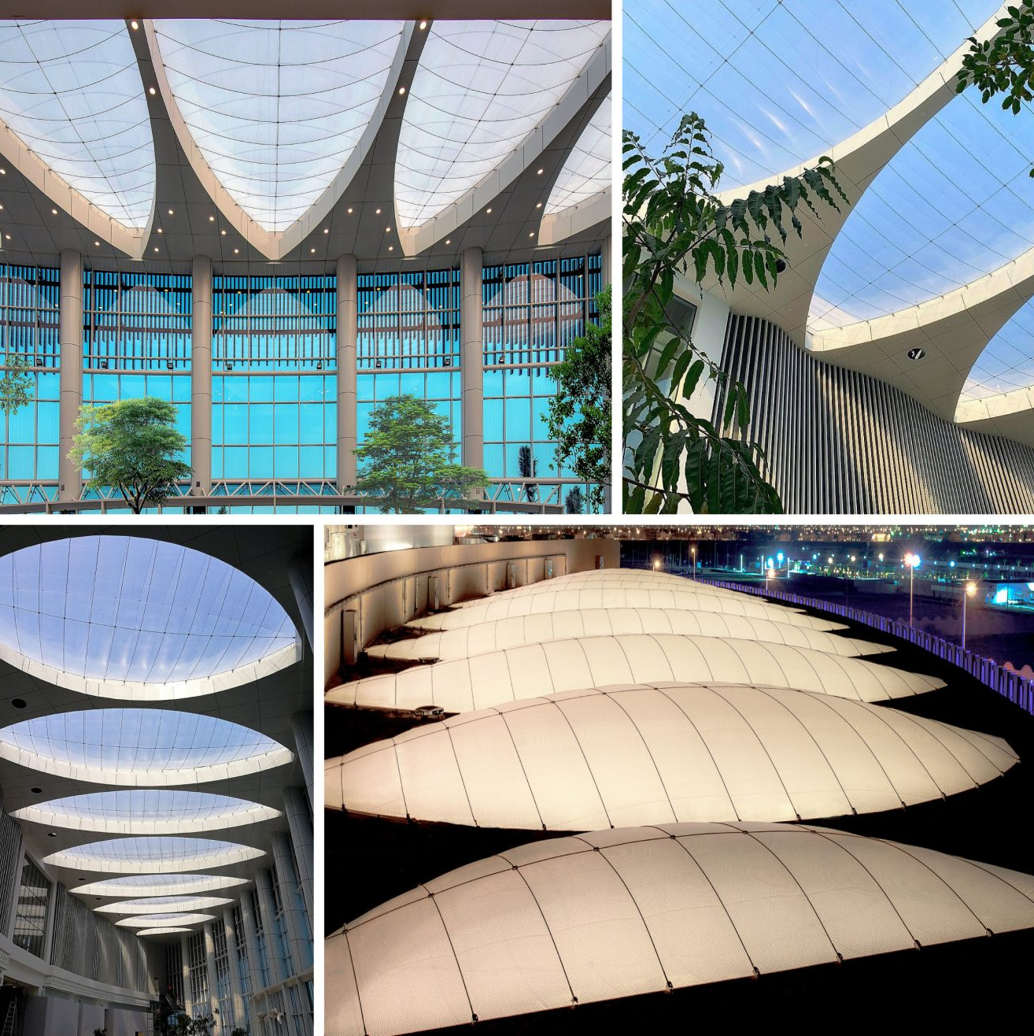
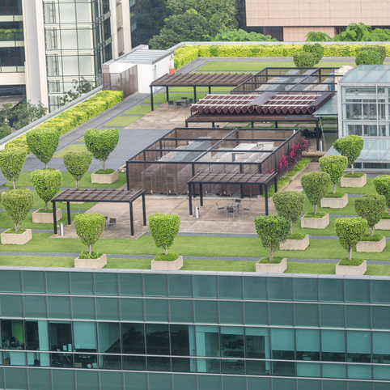
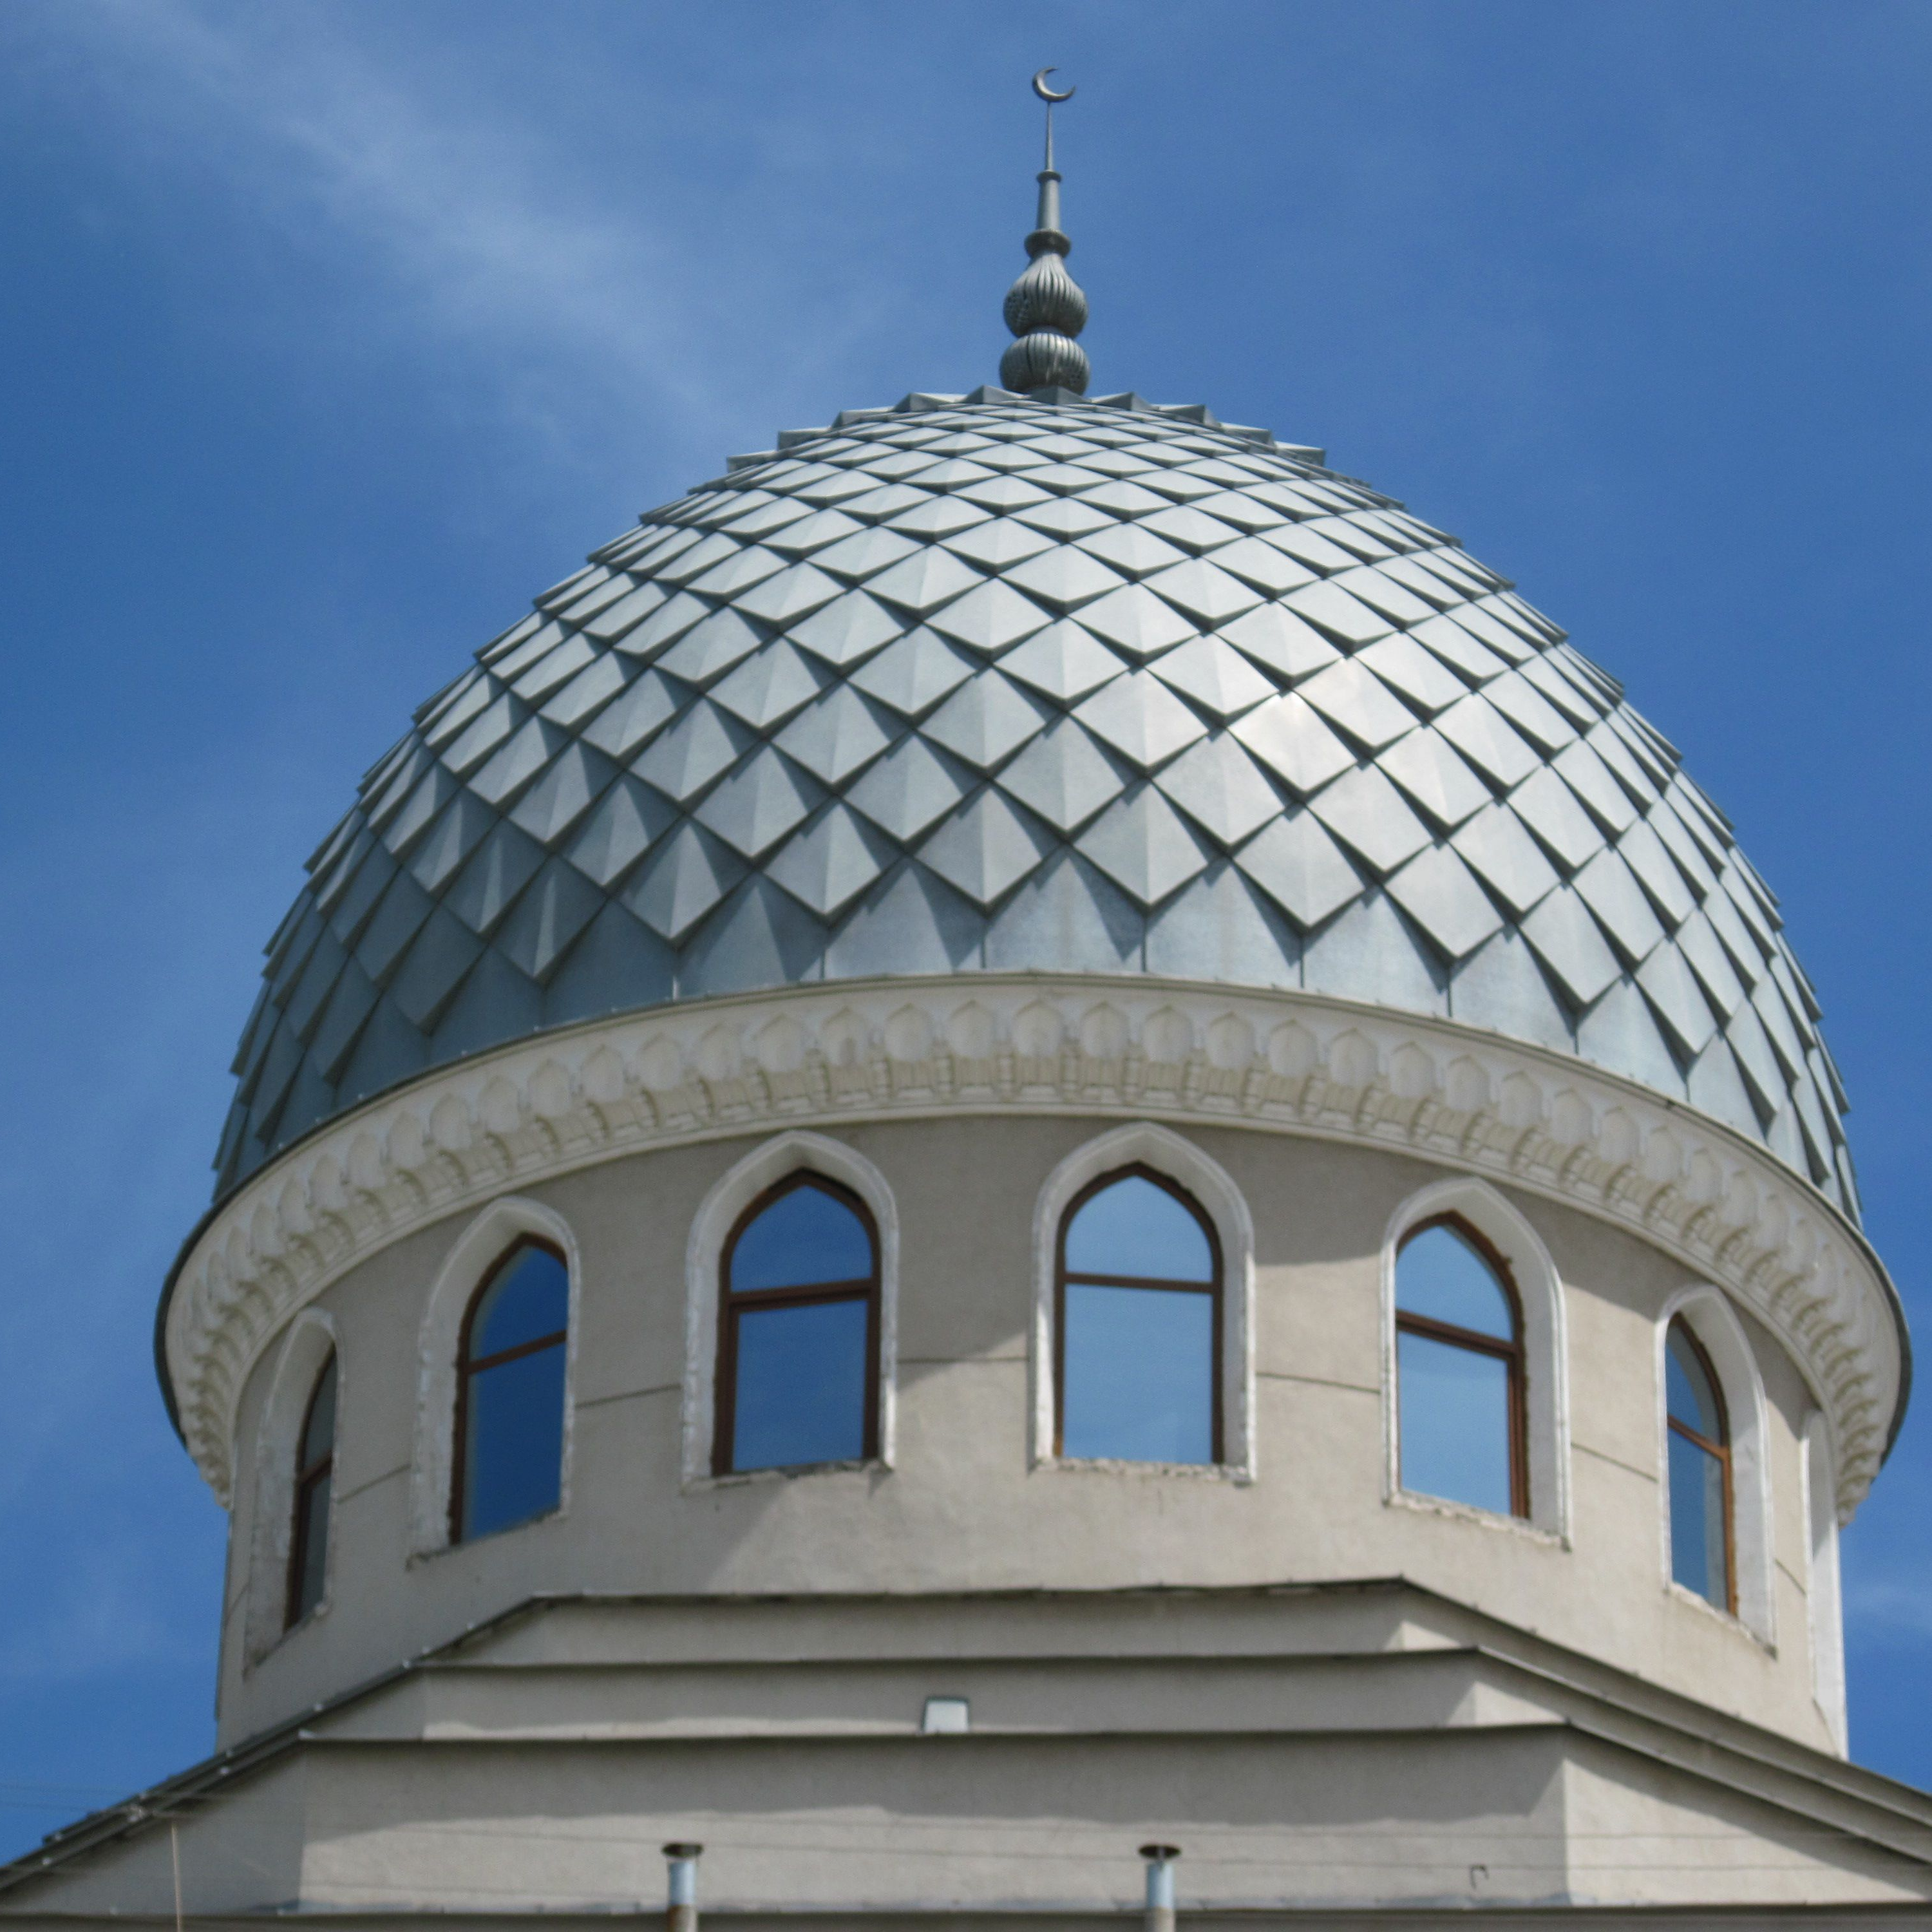
Other Roofing Options
Skylight
ETFE & Inflatable Systems
Green Roof
Domed Structure
Glass fixtures and sealing systems
Inflatable Membranes for Curved Roofs
Grass and Small Plants
Self Supporting Structures – Similar to Arches

Slide 35
Design to actualization
Applying Engineering to Design Concept

Slide 36
Applied Engineering
Identify Each Design Structure
Select Material Composition
Integrate With Materials
Room Type
Special Design Features
Roof type
Exterior Temp/Perm Feature
Supporting Structure
Exterior Fittings
Interior Composition (Walls)
Water Control
Interior Walls
Finishes
Special Features

Slide 37
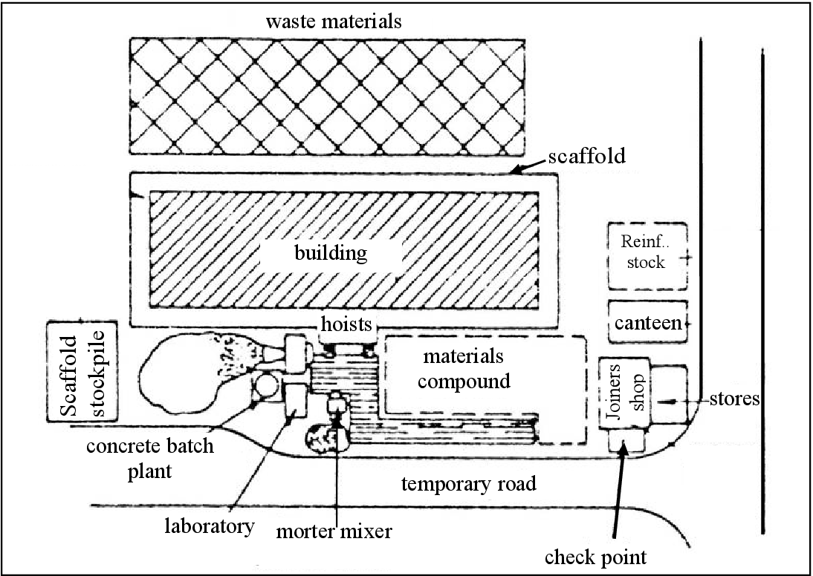
Applied Engineering - Site Plan

Slide 38
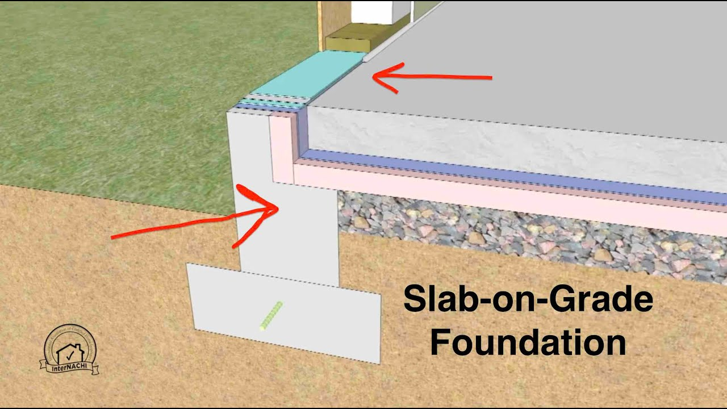
Applied Engineering – Foundation

Slide 39
Applied Engineering – Core/Shell/Roofing

Slide 40
Bringing this all together
Apply these concepts to your drawing.
What is your vision?

Slide 41
THANK YOU
L. Jackson, V.A. Jump, K. Minderlein, B. Hopkins

