Slide 1

Construction Management
ACE Mentorship – Old Mill High school

Slide 2

Course PROGRESS
Lesson 1. Contract – From Owner
Lesson 4. Coordination & Execution
Lesson 5. Substantial Completion
Lesson 2. Procurement
Lesson 3. Planning & Site Utilization

Slide 3
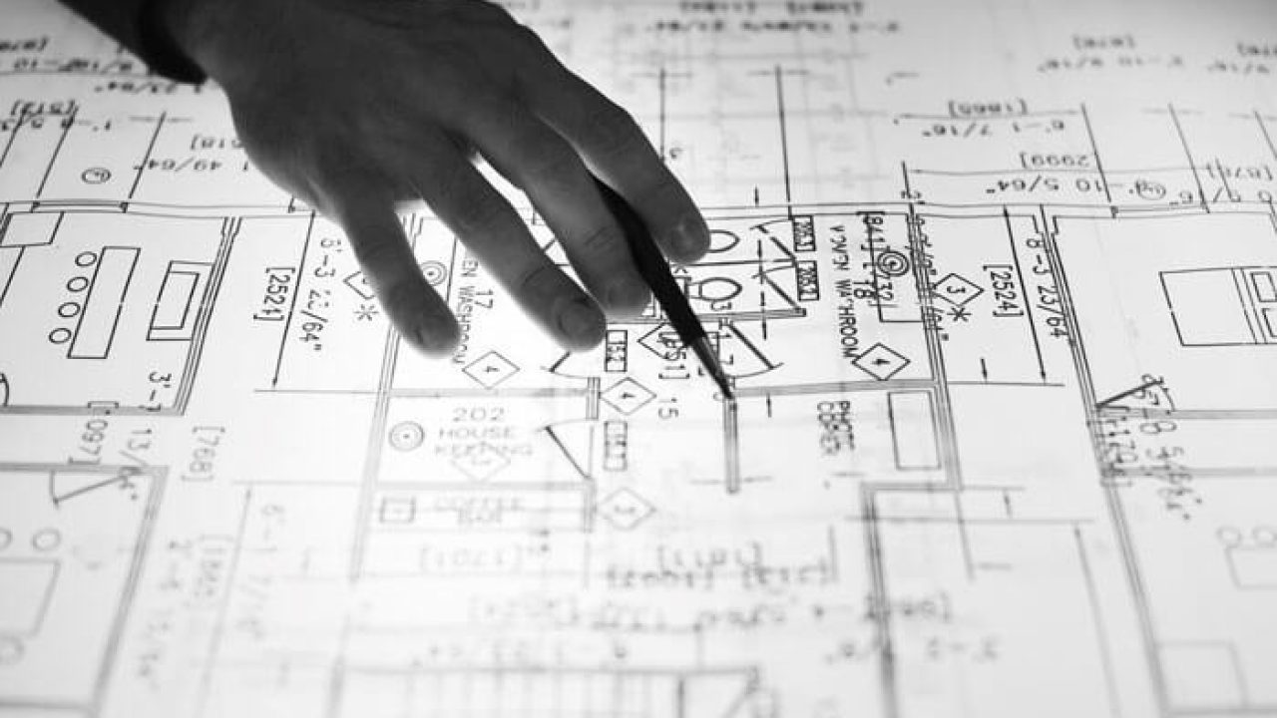
Construction management - COORDINATION
What is “coordination”?
  Shop Drawings
  Coordination Drawings
  BIM
  Ensuring drawings/specifications are in alignment

Slide 4
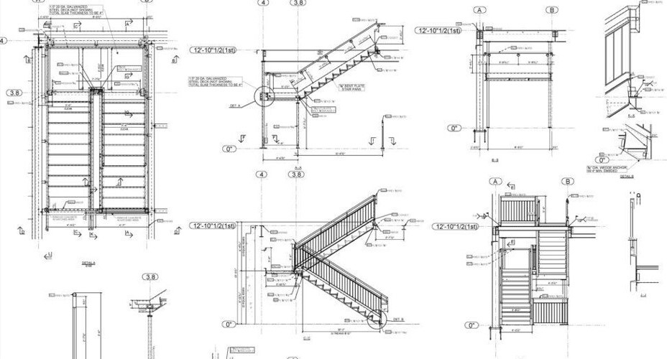
Construction management - SHOP DRAWINGS
Purpose
  Translates architect’s intent into buildable products
  Shows subcontractor understands contract drawings and includes all design elements
  Includes details architect may not have included
  Identifies conflicts in design or “unbuildable” designs

Slide 5
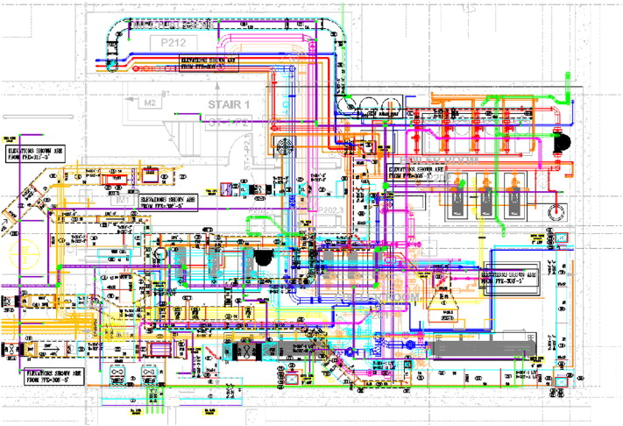
Construction manager – Coordination Drawings
Typically include:
  Electrical
  Mechanical (HVAC) ductwork and piping
  Plumbing
  Fire Protection (Sprinkler Systems)
  Some low voltage
    Telecommunications
    Fire Alarm
    Security
  Architectural Walls and Finishes

Slide 6
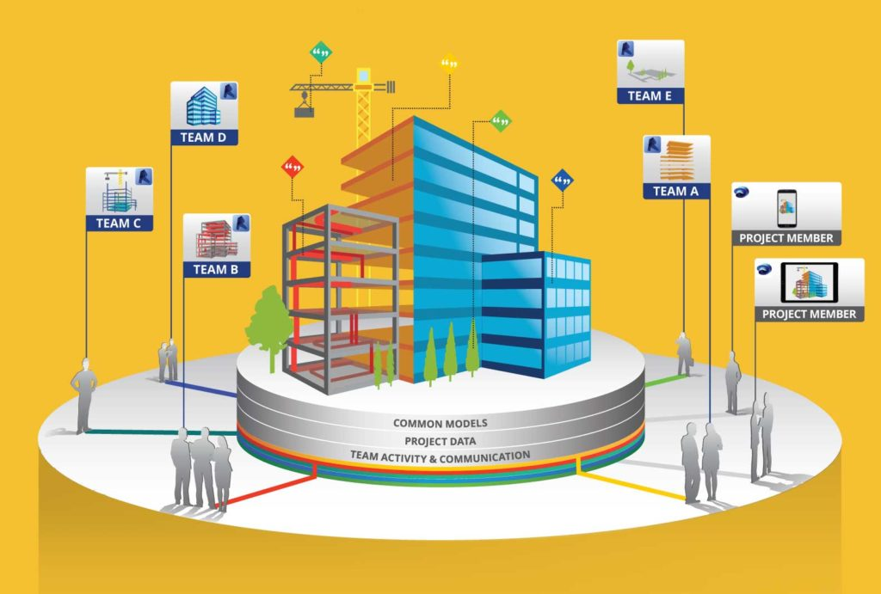
Construction manager - bim
What is BIM?
  Building Information Modeling
Integrated solution where multiple disciplines share individual models to create a single project model
Includes design and systems but can also include:
  Operation and Maintenance information
  Monetary Information
  Construction sequencing

Slide 7
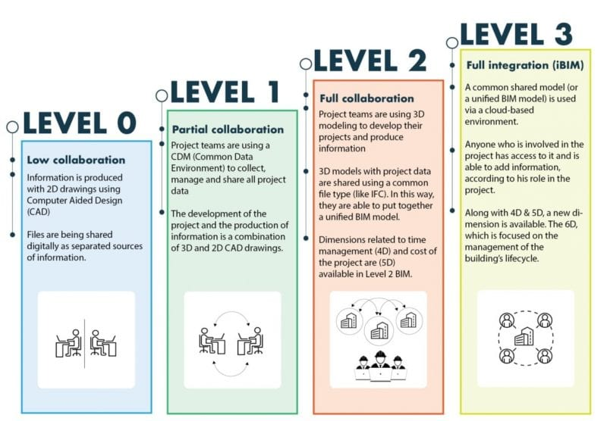
Construction manager - bim

Slide 8
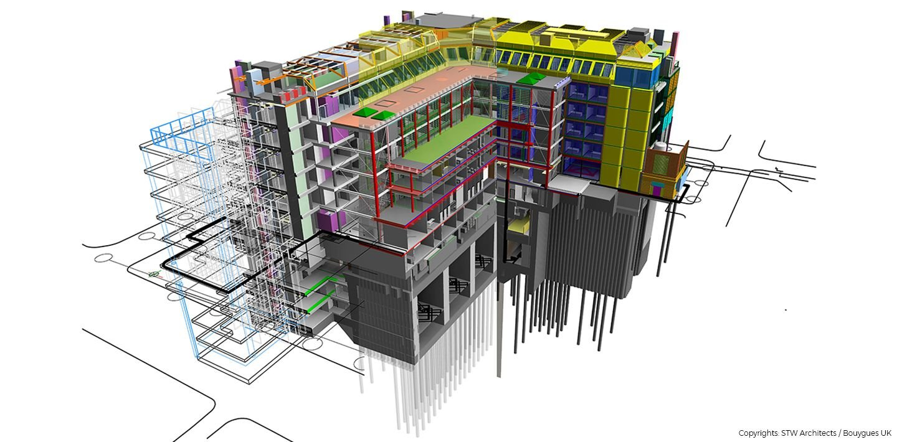
Construction manager - bim

Slide 9
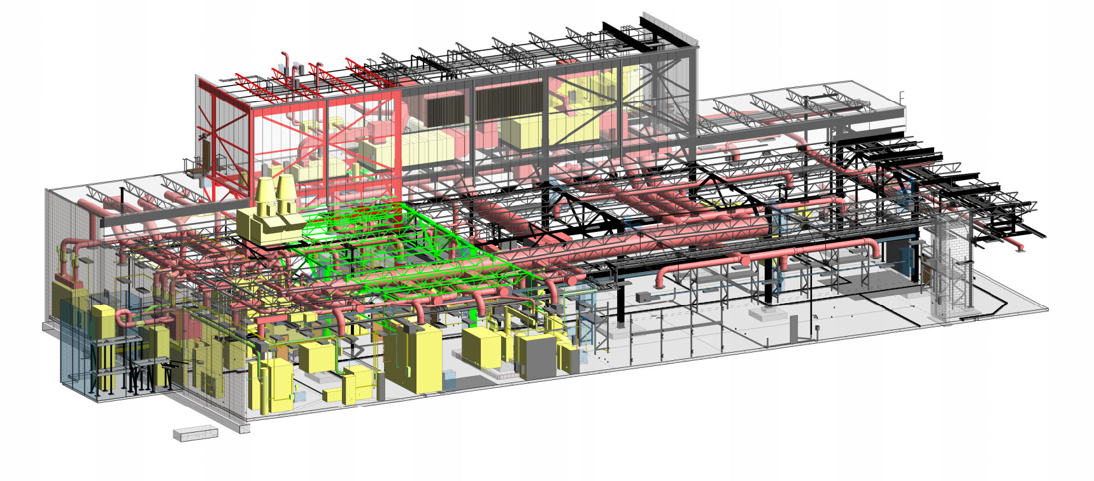
Construction manager - bim

Slide 10

Construction manager – Execution
Major Project Milestones
  Construction Administration
    Owner Contract
    Subcontract Award
    Submittals
      Shop Drawings
      Product Data
      Coordination Drawings
    Permitting
      Building Permit
      Trade Permits

Slide 11
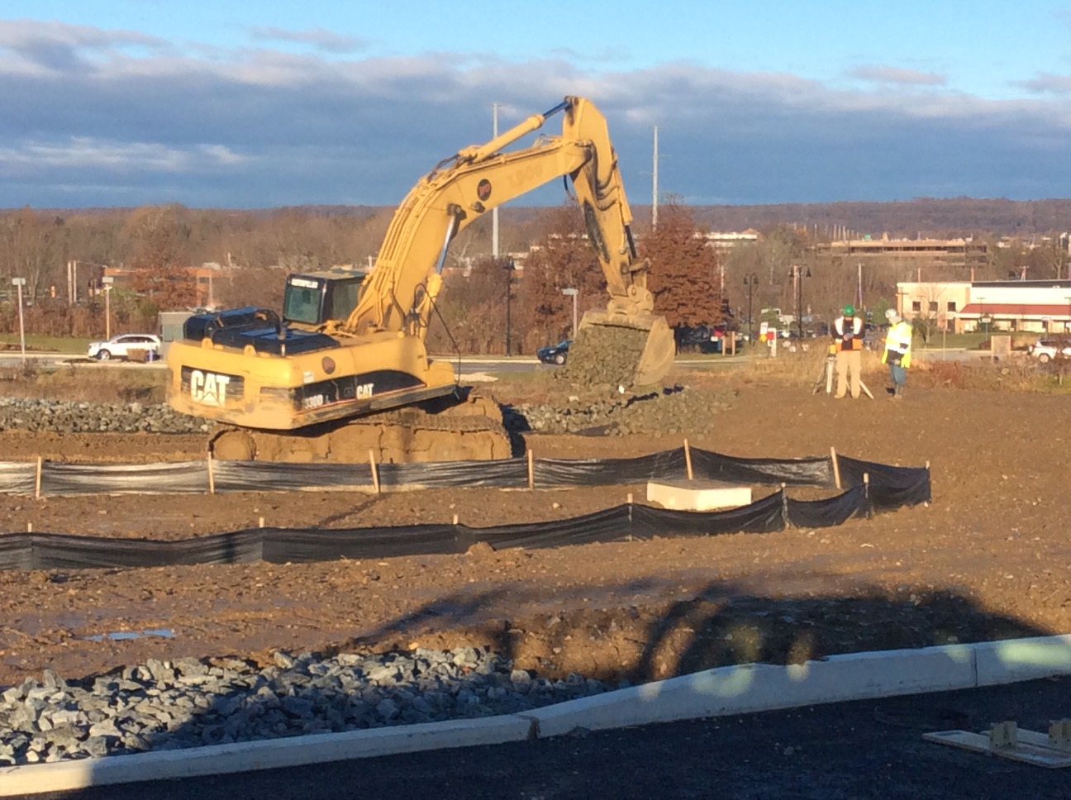
Construction manager – Execution
Major Project Milestones
  Ground Breaking
    Site Utilities
      Power
      Water
      Storm
    Sediment & Erosion Control
    Excavation
    Grading

Slide 12
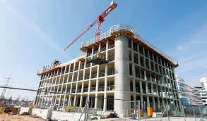

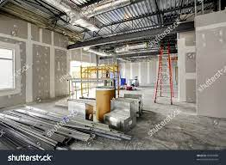
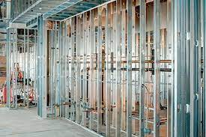

Construction manager – Execution
Major Project Milestones
  Foundation
  Structure
  Skin/Envelope
  Interior Partitions
  In-wall / Above Ceiling MEP
  Finishes
  Furniture
  Inspections
  Substantial Completion

Slide 13


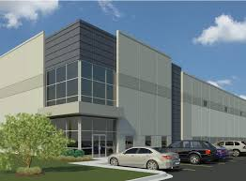

Construction manager – Execution
Substantial Completion – Owner has beneficial use
    Inspections Complete
      Building Inspector
      MEP
      Elevator
      Health Department
      Fire Marshall
      Use & Occupancy
    Sediment & Erosion Controls Removed
Final Closeout
  Warranty
  Operation & Maintenance Manuals
  Training
  Final Billing & Payments

Slide 14
Construction manager – Execution
Questions?

Slide 15
Deliverable Site Utilization Plan
Exterior
Interior
Fencing/Entrance & Exit Gates
Water Reclamation/Soil Control
Material Delivery
Jobsite Trailers – Owner/GC
Rubbish Removal
Temp Sanitary
Temp Utilities
Parking
Muster Area/Rally Point
Signage
Temp Sanitary
First Air Location(s)
Material Storage
Temp Fire Protection

Slide 16
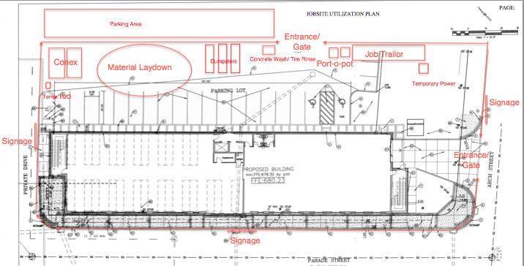
Deliverable - Site utilization Plan

