Slide 1
Architects
    Presentation by: Jody Gibson

Slide 2
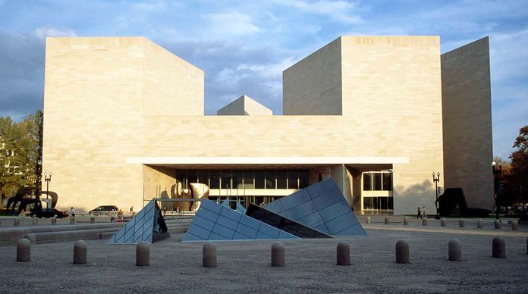
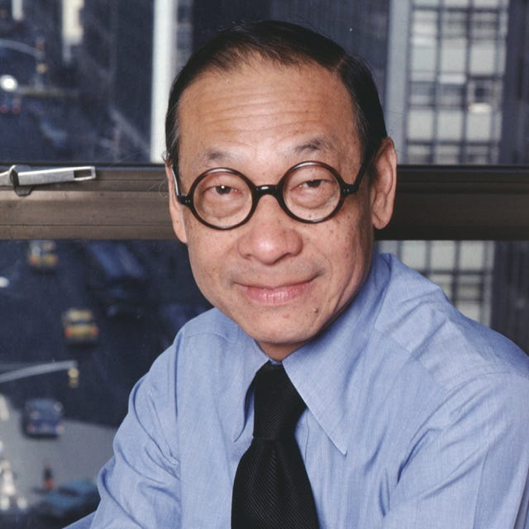
I.M. Pei
East Building National Gallery of Art – Washington, DC

Slide 3
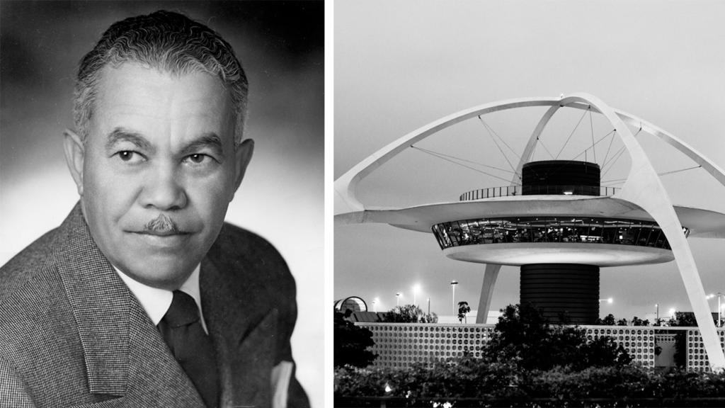
Paul Revere Williams
LAX Theme Building – Los Angeles, California

Slide 4
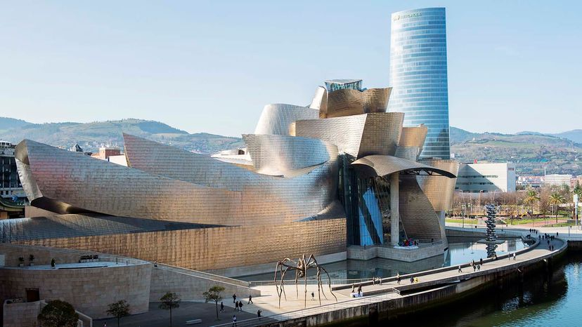
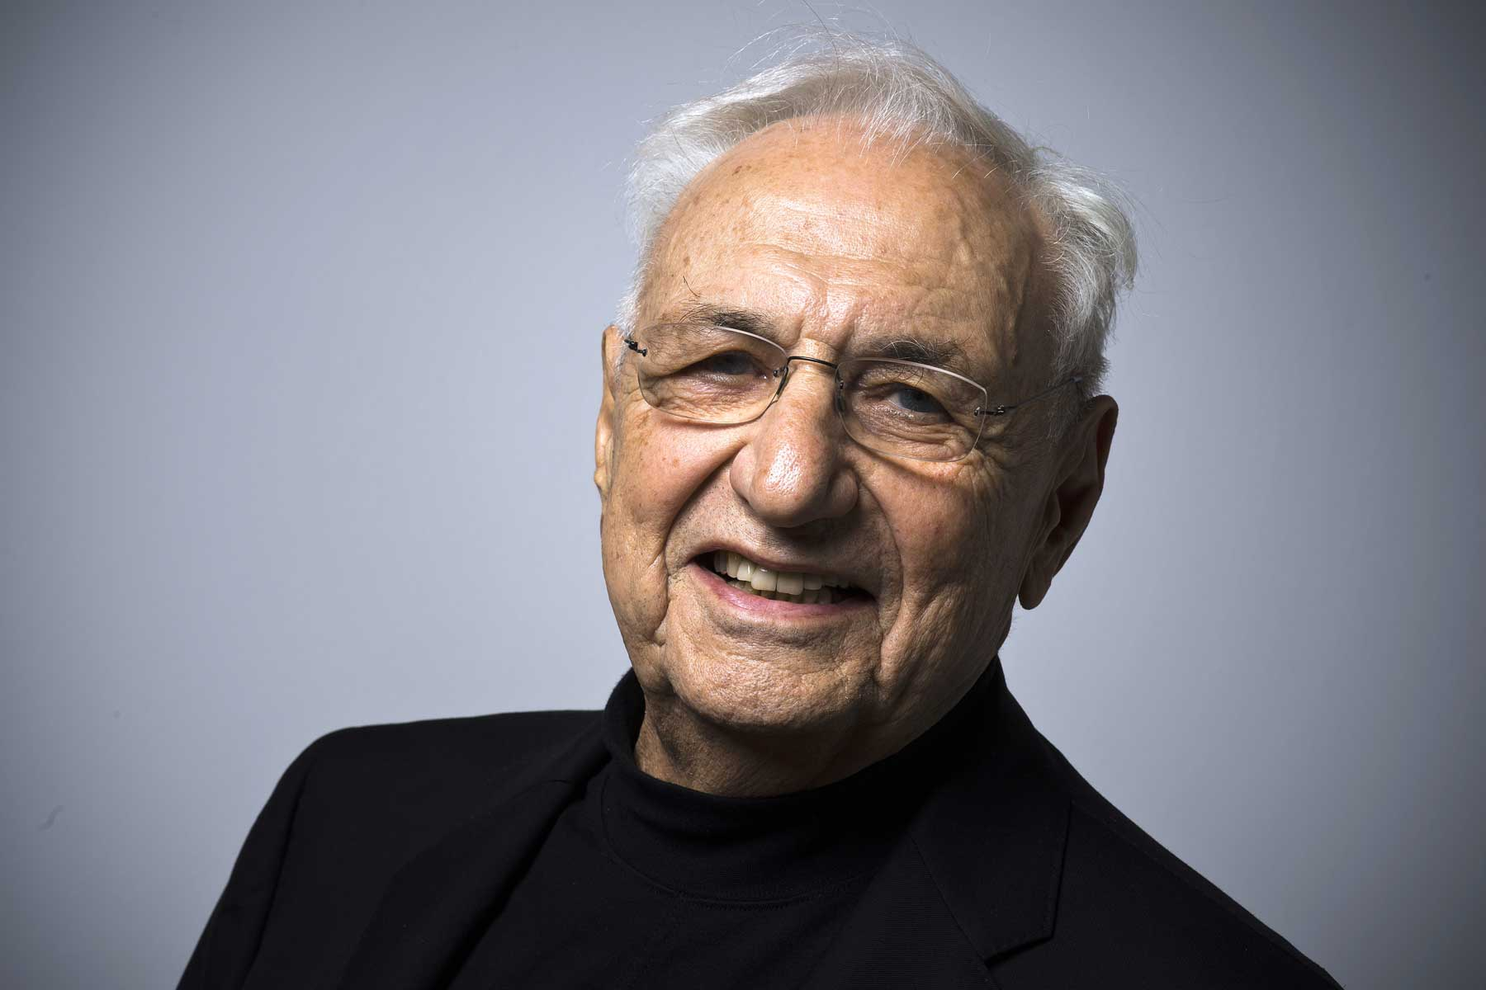
Frank Gehry
The Guggenheim Museum – Bilbao, Spain

Slide 5
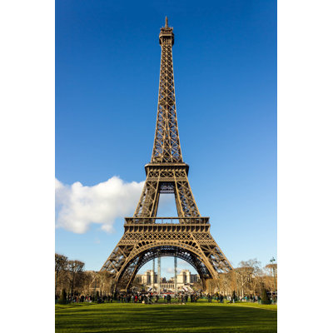
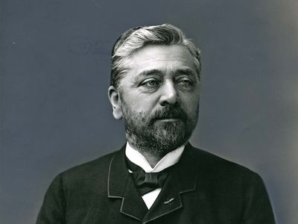
Gustave Eiffel
Eiffel Tower – Paris, France

Slide 6
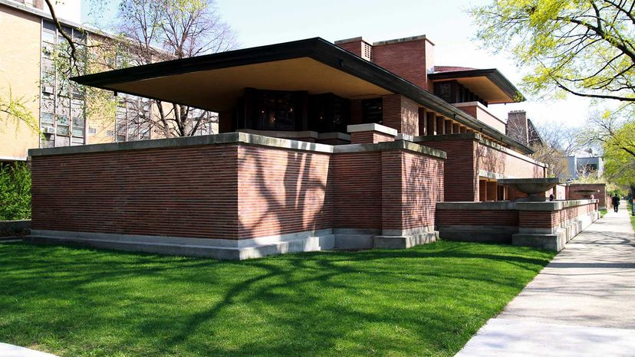
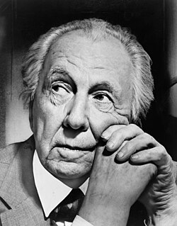
Frank Lloyd Wright
The Frederick C. Robie House – Chicago, Illinois

Slide 7
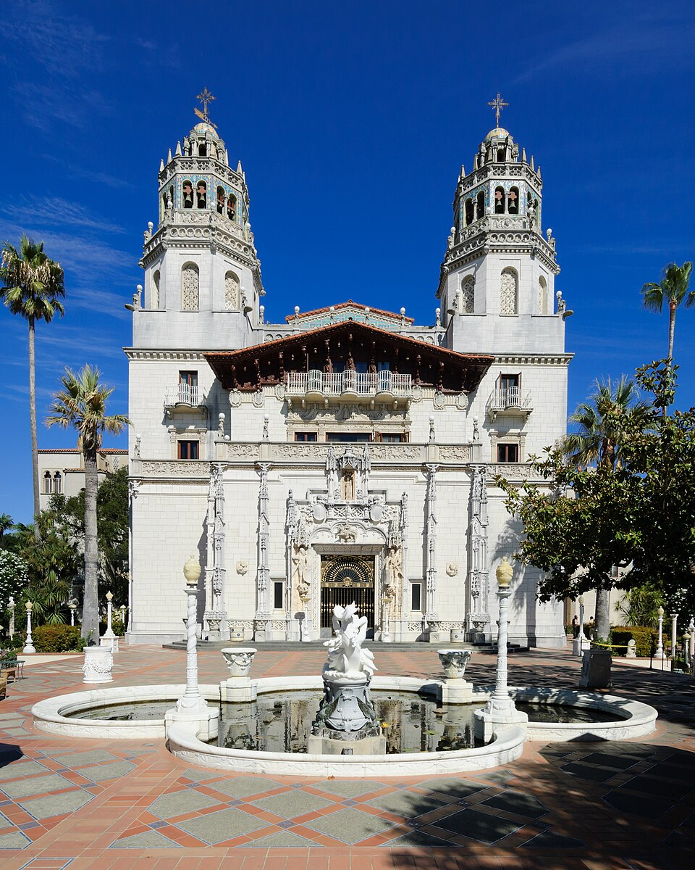
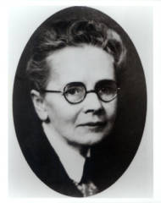
Julia Morgan
Hurst Castle –
San Simion, California

Slide 8
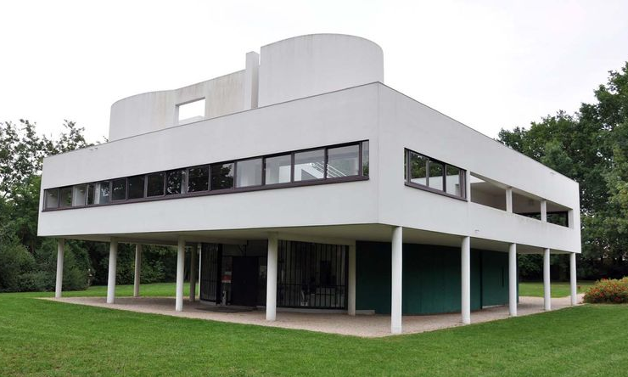
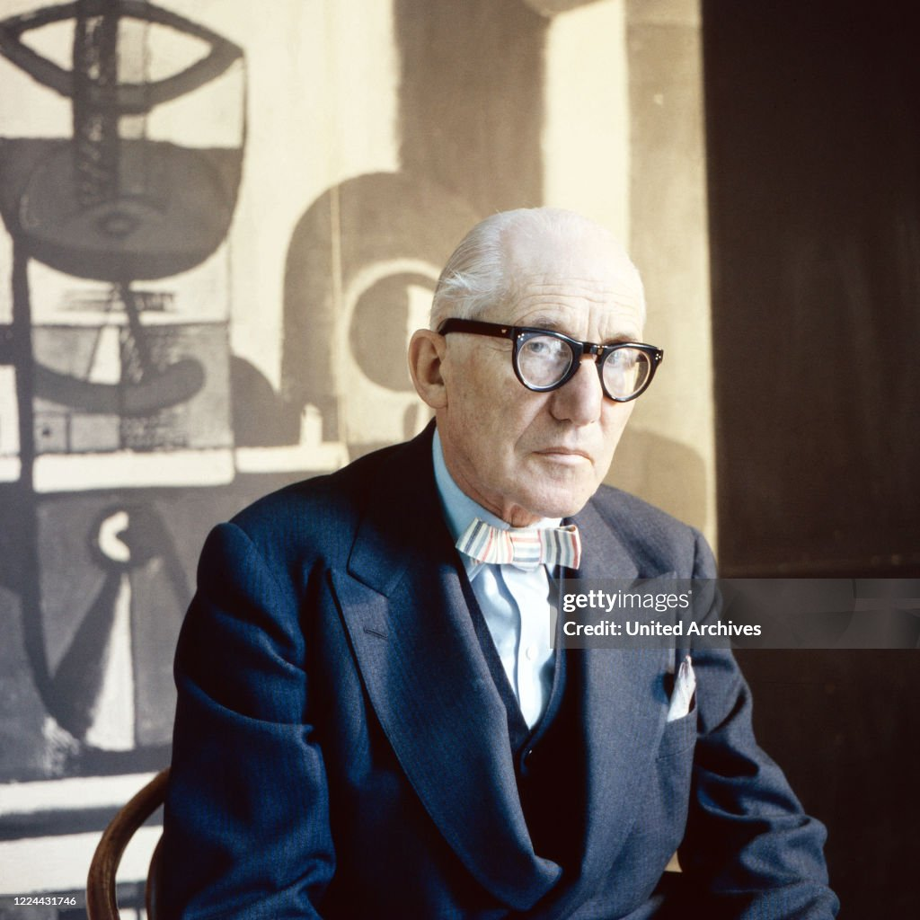
Corbusier
Villa Savoye - Poissy, France

Slide 9
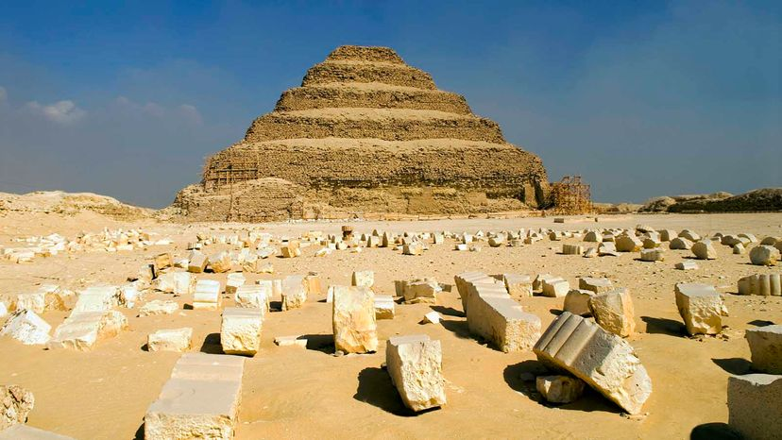
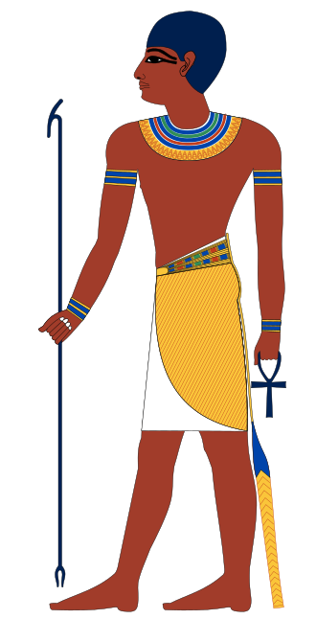
Imhotep
Step Pyramid of Dosier – Saqqara, Egypt

Slide 10
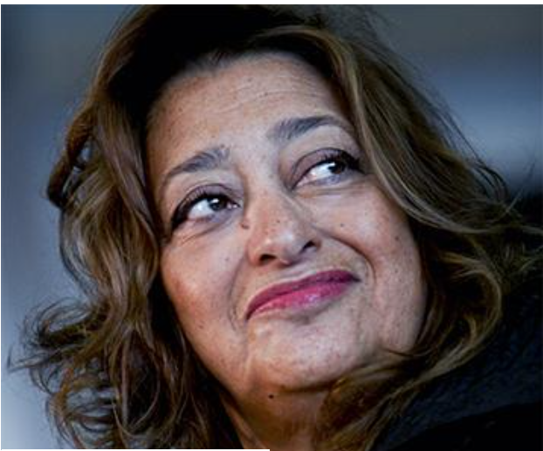
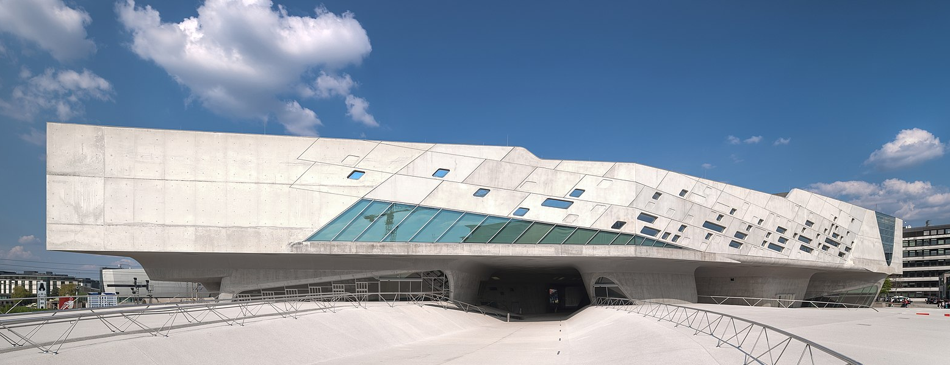
Dame Zaha Hadid
The Phæno Science Center – Wolfsburg, Germany

Slide 11
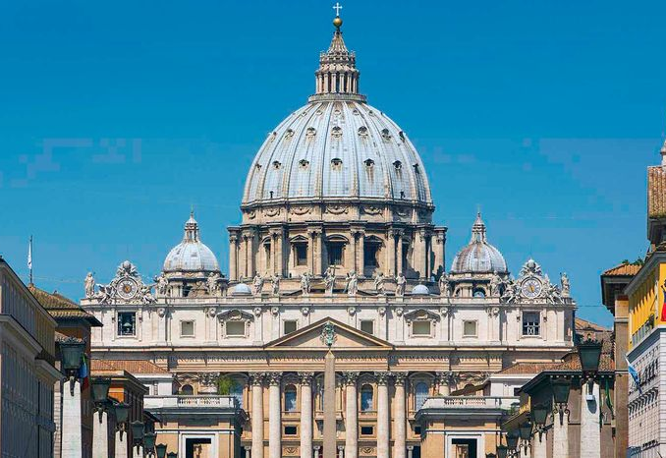
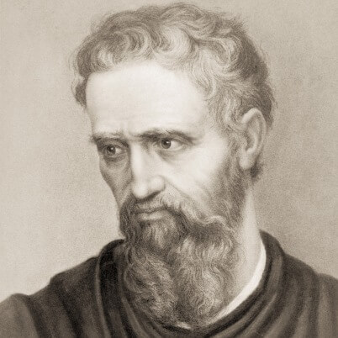
Michaelangelo
St. Peter's Basilica -Vatican City, Italy

Slide 12
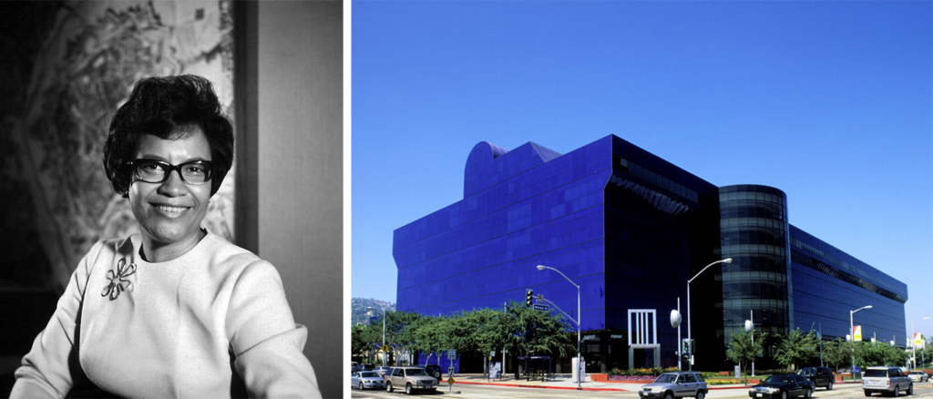
Norma Merrick Sklarek
Pacific Design CenterWest - Hollywood, California

Slide 13
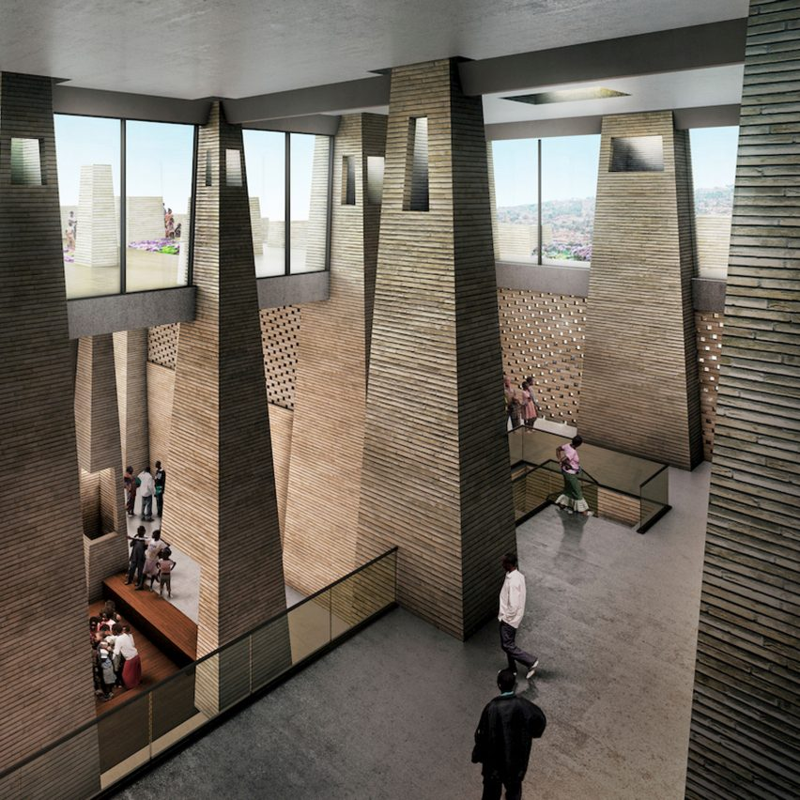

Christian Benimana
Proposed Project -
Mass Design Group, Rwanda

Slide 14
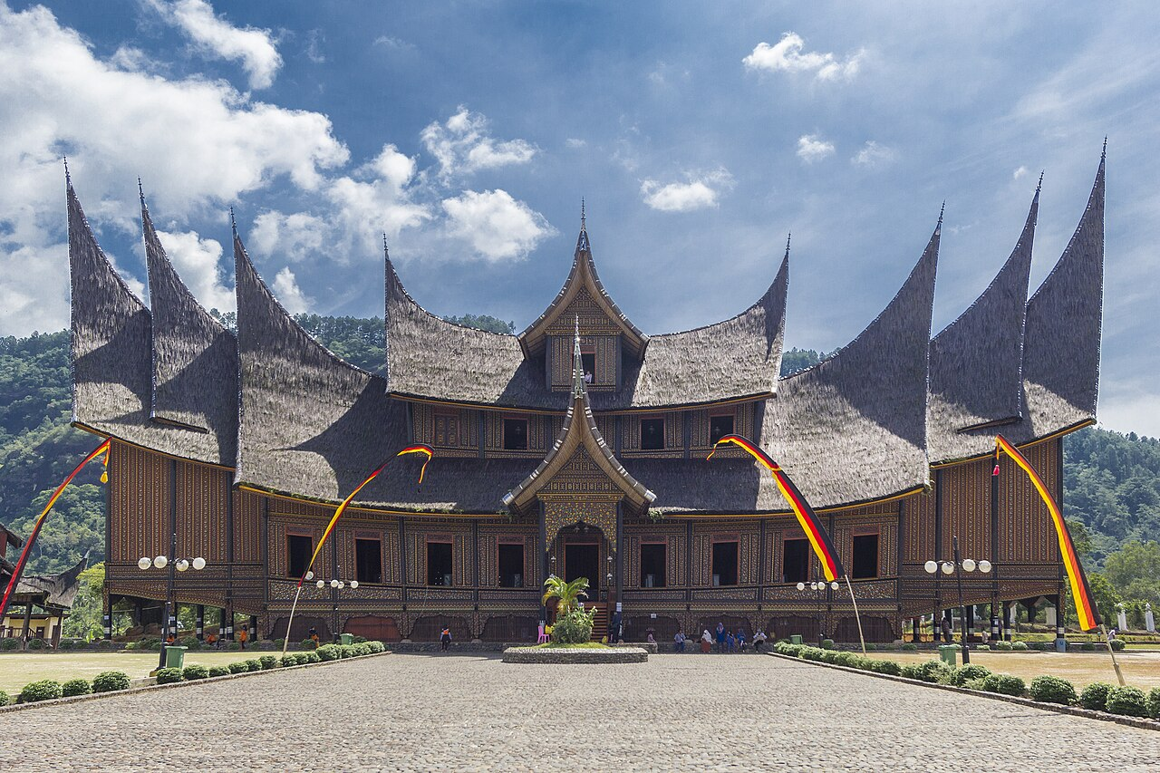
Pagaruyung Palace, Minangkabau, West Sumatra

